Slide 1
DEVSECOPS

Slide 2
SAST, IAST, DAST, RAST
SAST
Static Application Security Testing
Static analysis, is a testing methodology that analyzes source code to find security vulnerabilities that make your organization’s applications susceptible to attack. “SAST” scans an application before the code is compiled. It's also known as white box testing.
IAST
Interactive Application Security Testing
IAST analyzes code for security vulnerabilities while the app is run by an automated test, human tester, or any activity “interacting” with the application functionality... IAST works best when deployed in a QA environment with automated functional tests running.
DAST
Dynamic Application Security Testing
A dynamic application security testing tool is a program which communicates with a web application through the web front-end in order to identify potential security vulnerabilities in the web application and architectural weaknesses. It performs a black-box test.
RAST
Run-time Application Security Protection
RASP, or Run-time Application Security Protection As with IAST, RASP, or Run­time Application Security Protection, works inside the application, but it is less a testing tool and more a security tool. It’s plugged into an application or its run­time environment and can control application execution.

Slide 3
SAST vs IAST vs DAST
SAST
White Box
Early & Fast
Development
Code
IAST
Grey Box
Fast
QA
Running App
DAST
Black Box
Slow Late
Security Gate
Attacks

Slide 4
Enabling security Governance & Compliance in DevSecOps
Understanding the need for Security Governance
Understanding the need for Security Compliance
Enabling security Governance & Compliance in DevSecOps
Understanding Compliance as Code
Applying Compliance as Code in DevSecOps

Slide 5

Governance, Risk & Security Compliance
Governance, risk management and compliance (GRC)
is the term covering an organization's approach across these three practices
https://en.wikipedia.org/wiki/Governance,_risk_management,_and_compliance

Slide 6
Compliance References
GDPR
PCI DSS
SOX & GLBA
HIPAA
Cyber Essentials
NIST

Slide 7
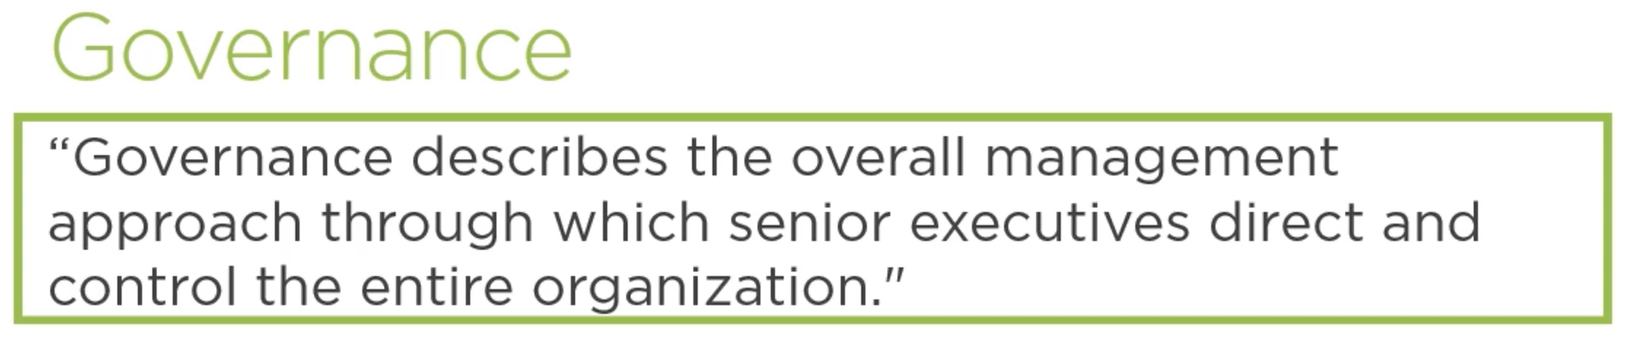
https://en.wikipedia.org/wiki/Governance,_risk_management,_and_compliance

Slide 8
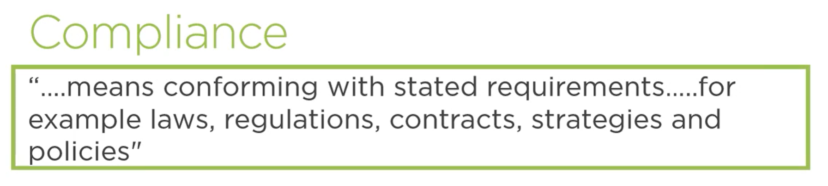
https://en.wikipedia.org/wiki/Governance,_risk_management,_and_compliance

Slide 9
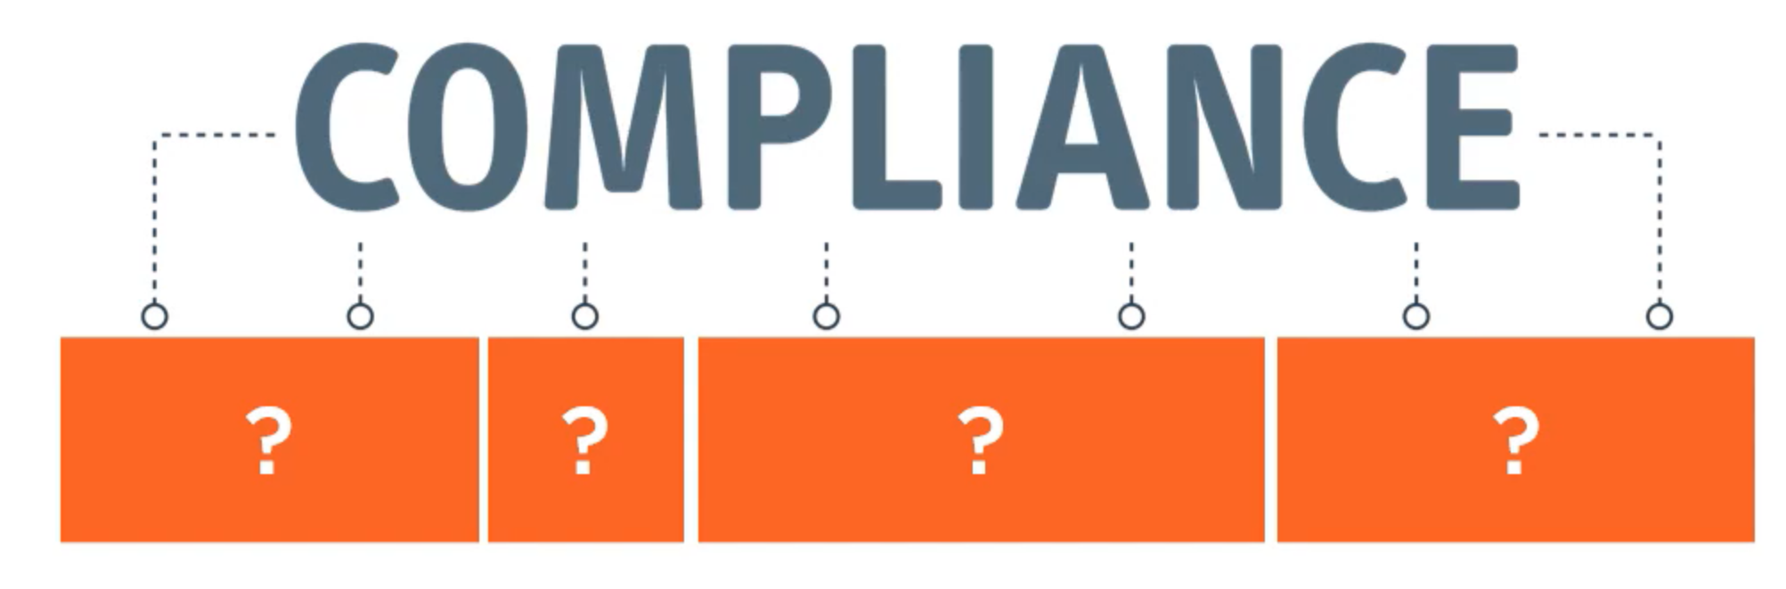
Why Security Compliance aims to achieve?

Slide 10
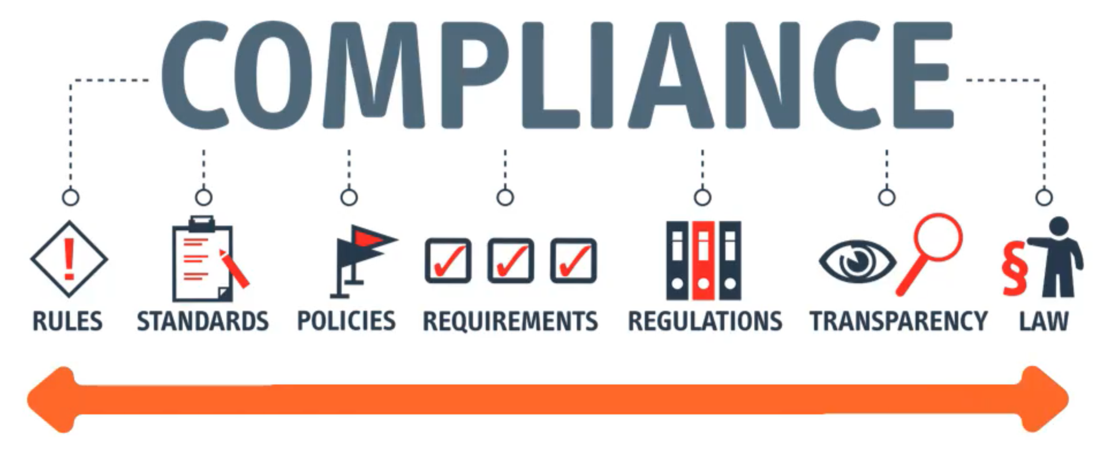
Why Security Compliance aims to achieve?
https://en.wikipedia.org/wiki/Governance,_risk_management,_and_compliance

Slide 11
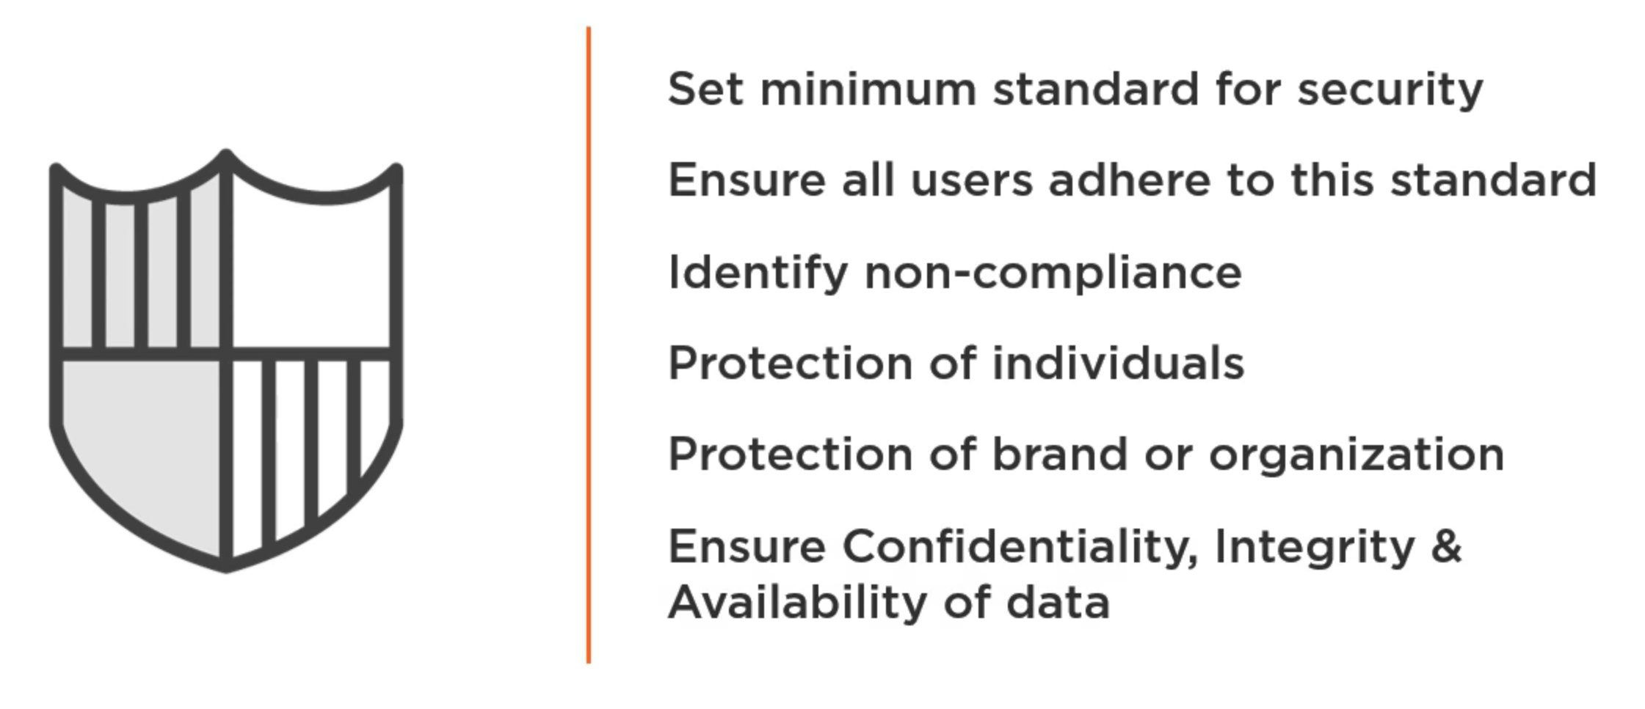
Why Security Compliance aims to achieve?

Slide 12
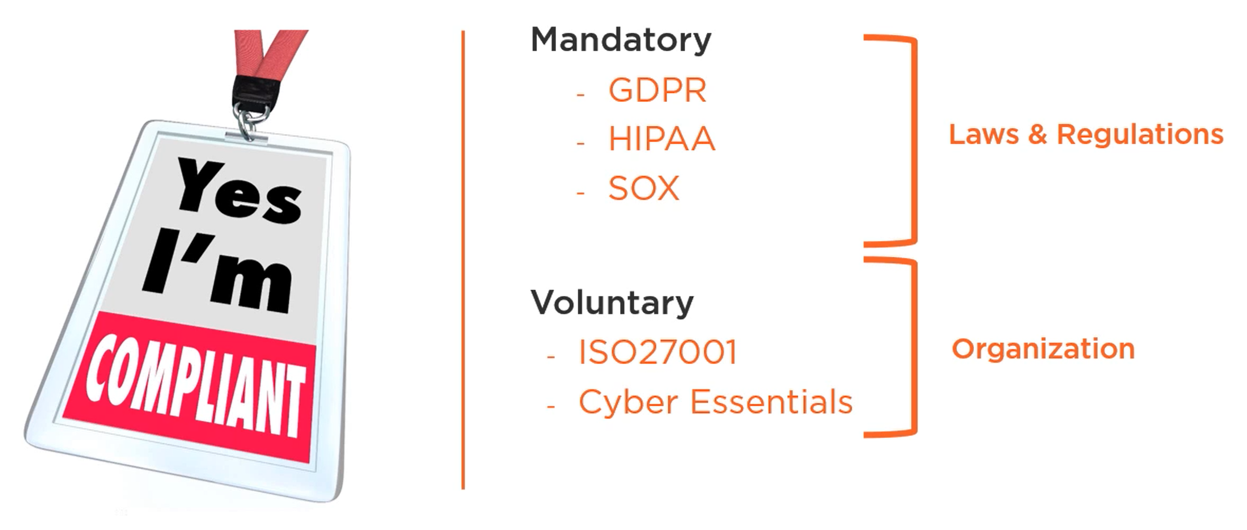
What determines Compliance is necessary?

Slide 13
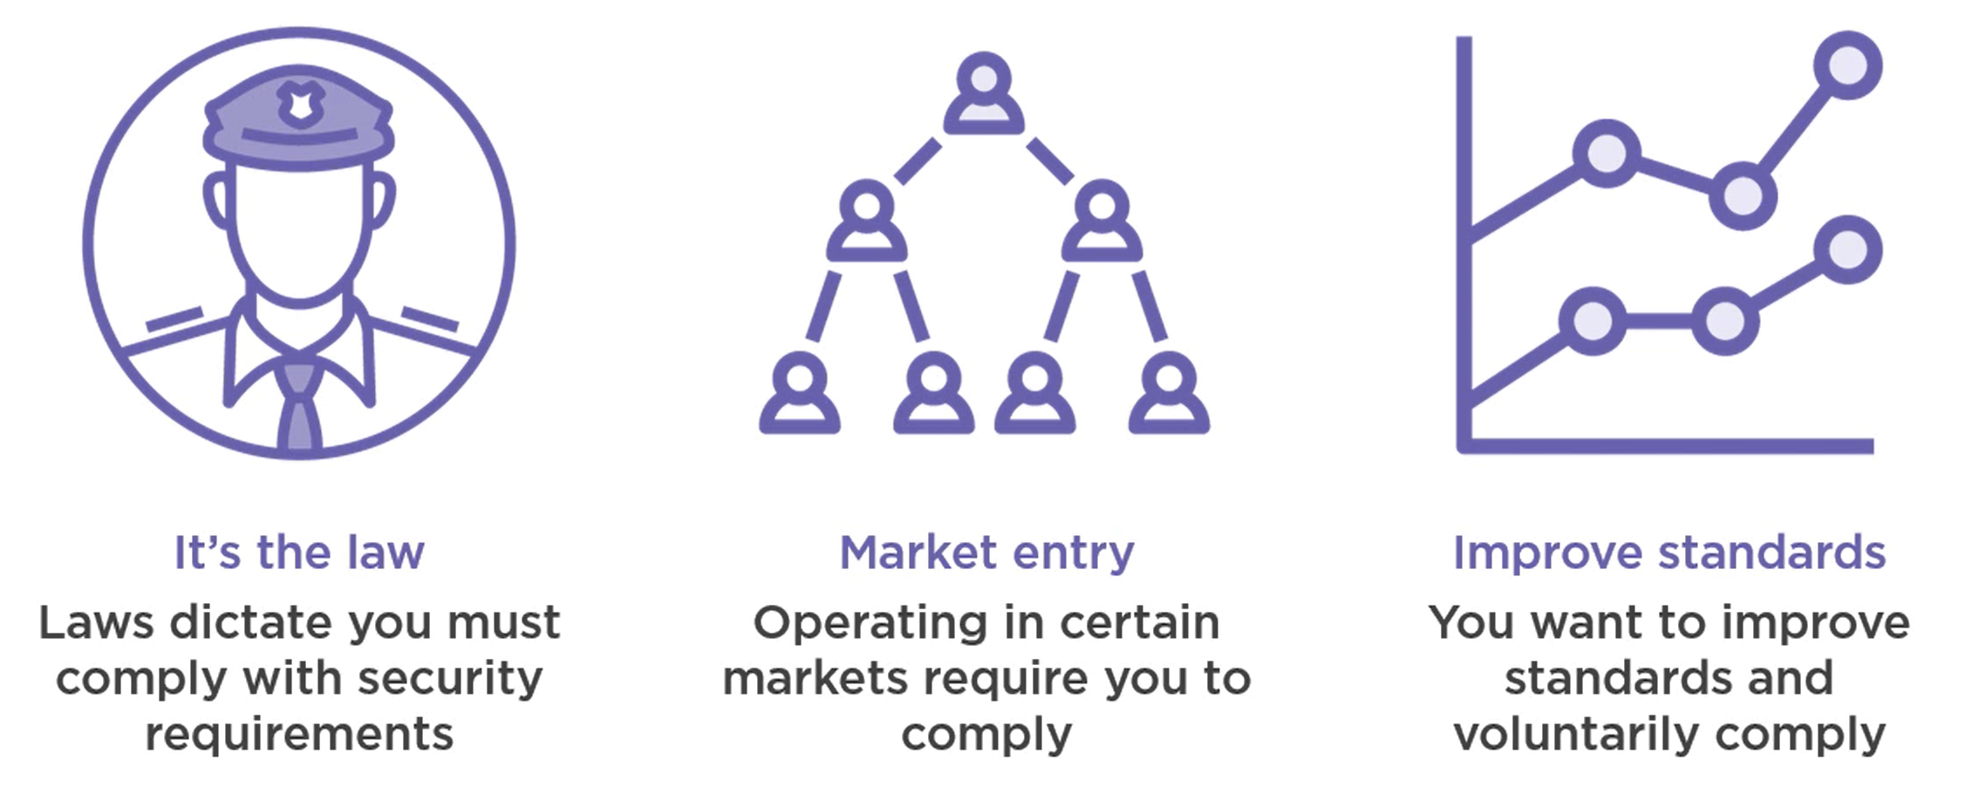
Why Comply?

Slide 14
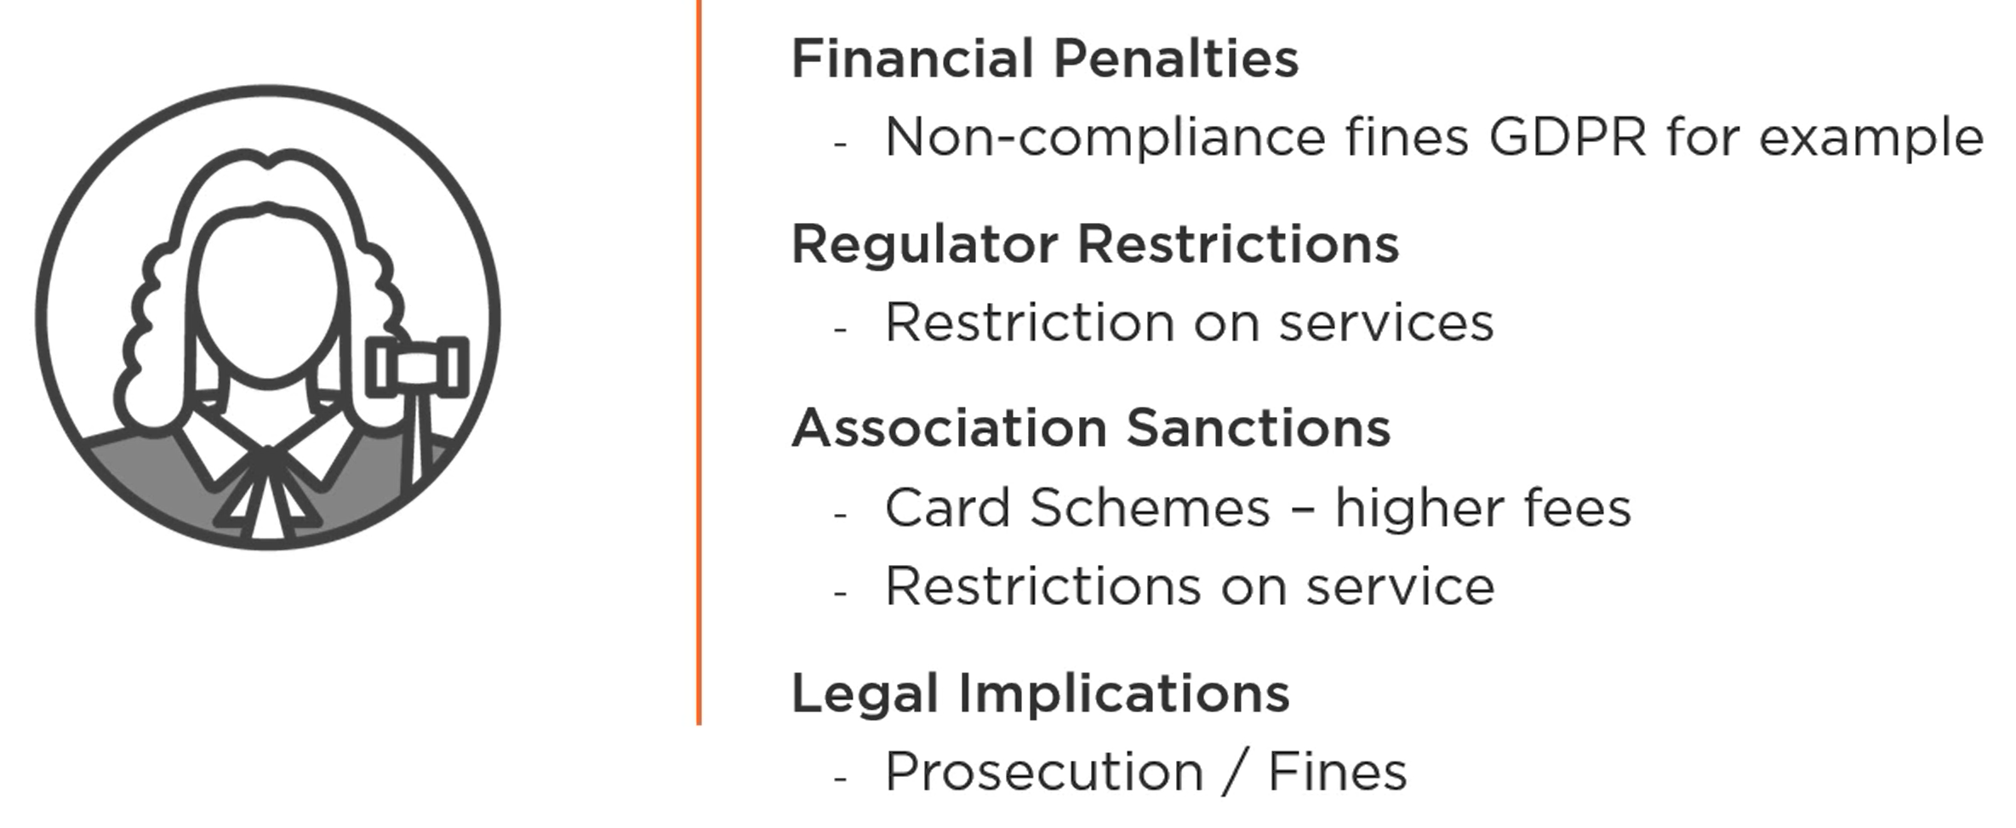
Disadvantages of Non - Compliance

Slide 15
Governance

Slide 16
Different types of Governance
Corporate Governance
Financial Governance
Project Governance
IT Governance
Public Governance
Seruity Governance

Slide 17
What Security Governance Aims to Achieve?
Set Approach for doing business
Culture and Integrity
Authority
Decision-Making
Accountability
How are we aligned to business goals

Slide 18
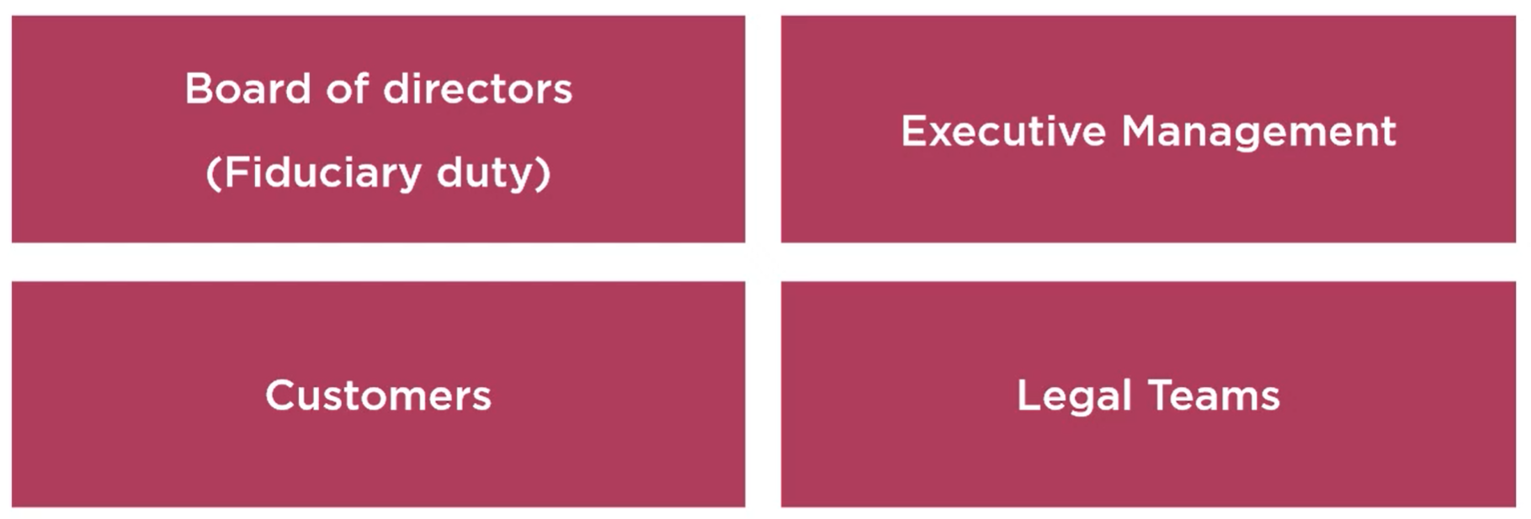
Key Stakeholders for Security Governance

Slide 19
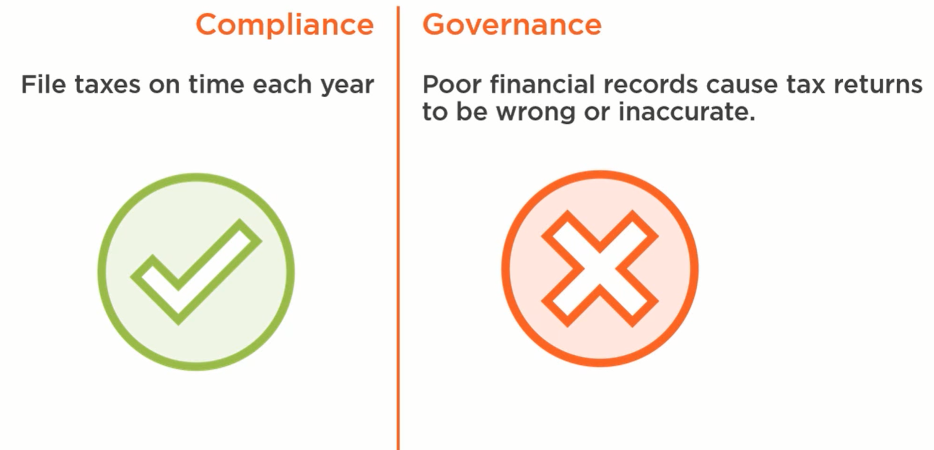
Compliance without Governance

Slide 20
Questions you may ask
Who can make changes in the CI/CD pipeline
How is code released to production
Who ensures code is vulnerability-free
Who is responsible for patching libraries

Slide 21
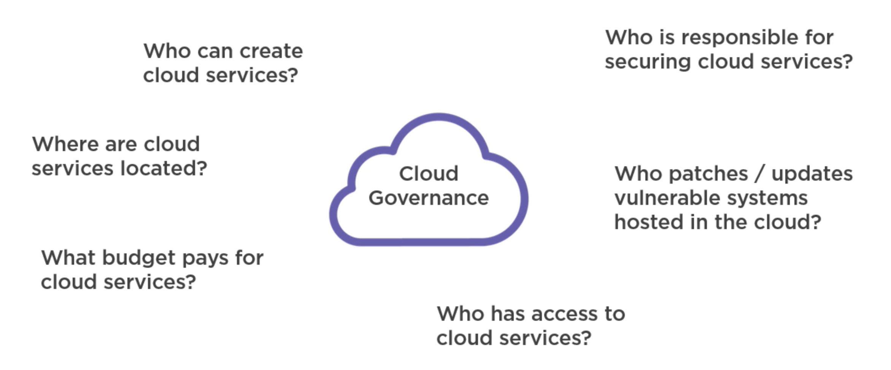
Challenges in Cloud Governance

Slide 22
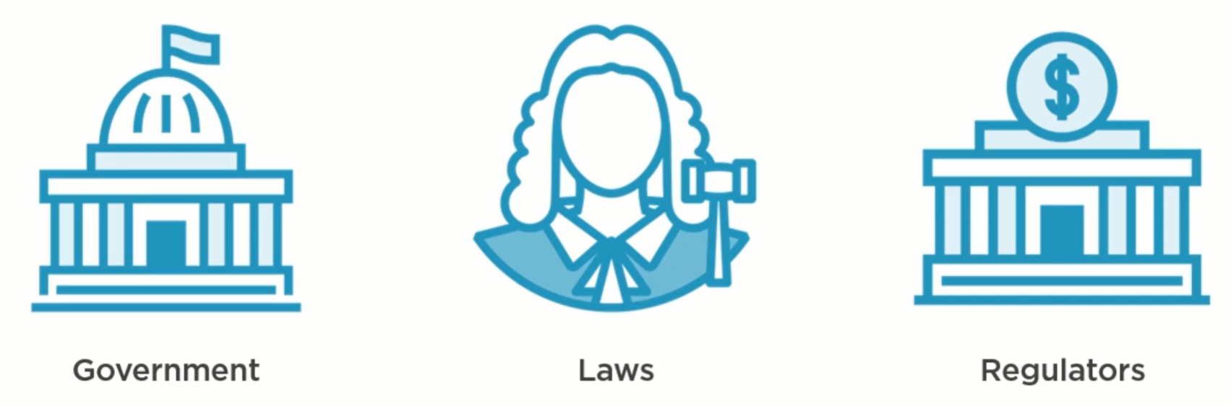
Increasing Focus on Governance

Slide 23
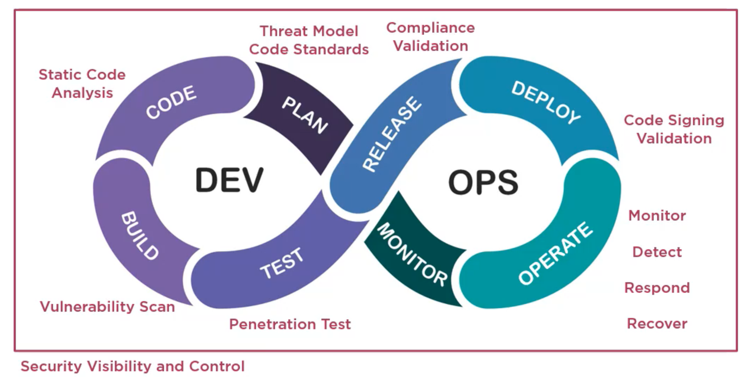
Impact of DevSecOps on Governance

Slide 24
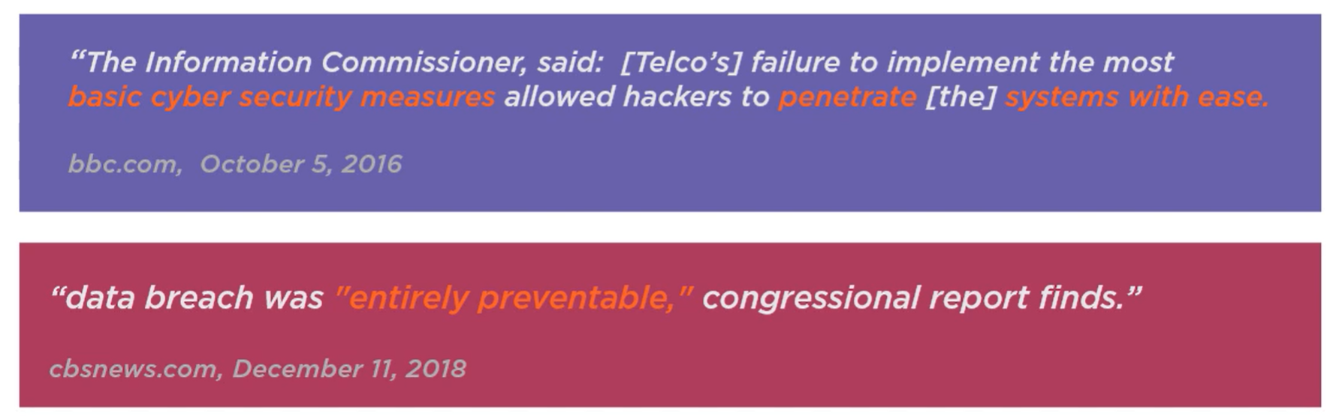
Real world example of poor Governance

Slide 25
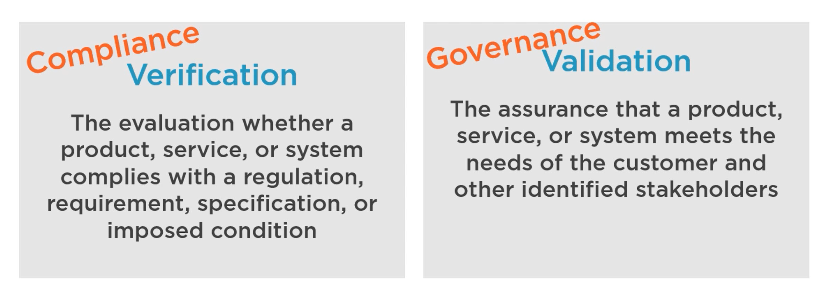
Understanding the need for Security Compliance

Slide 26
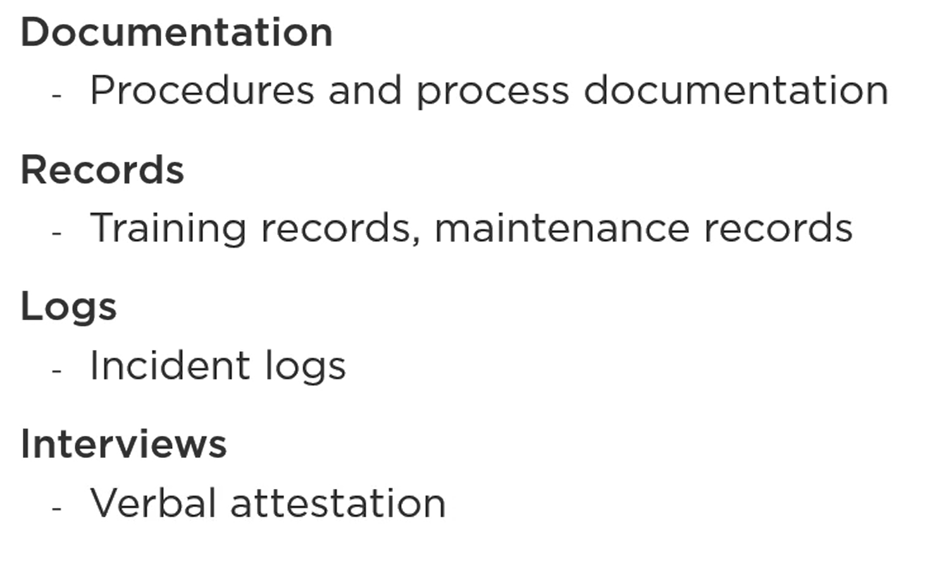
How to demonstrate Compliance?

Slide 27
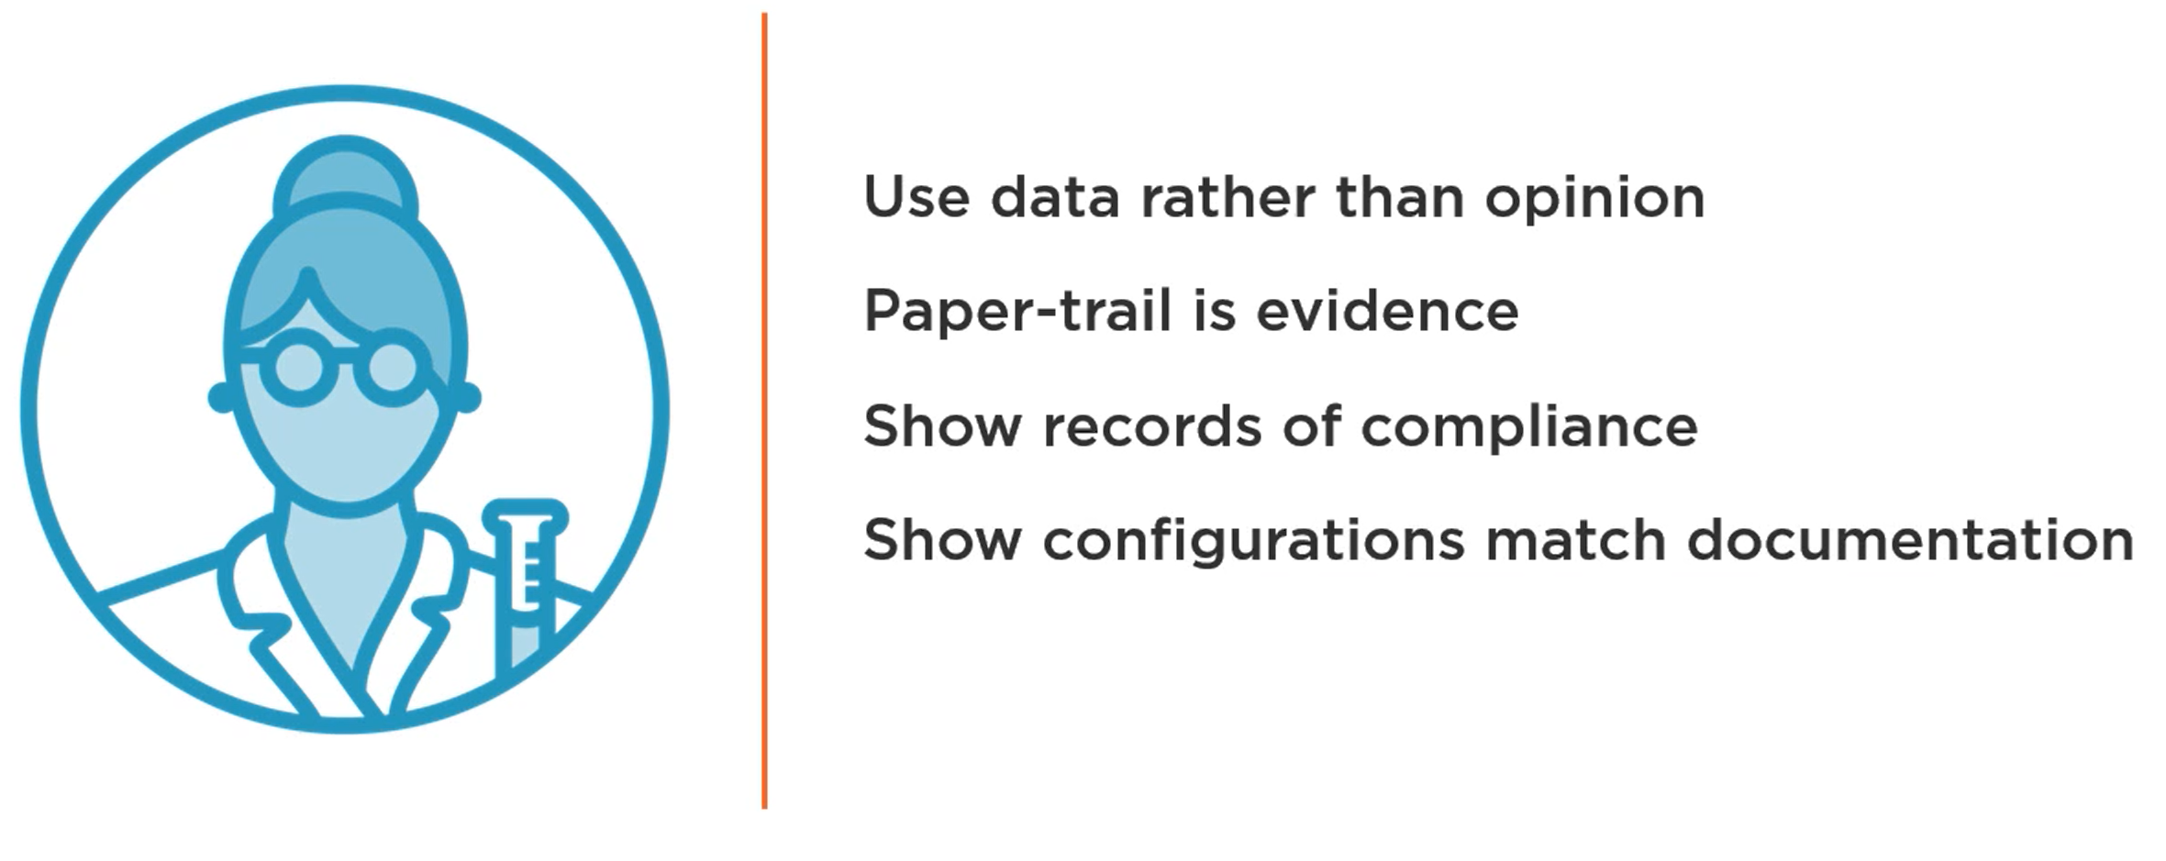
Using Evidence to Demonstrate Compliance

Slide 28

Security Compliance and Audit
Business Usual
Capture evidence during normal business
Mandatory Records
Ensure all mandatory records are being kept up to date
Identify Audit Sample
Review sample records for audit
Prepare Audit Evidence Pack
All evidence in one place
Audit Day
Day audit is scheduled to be undertaken

Slide 29
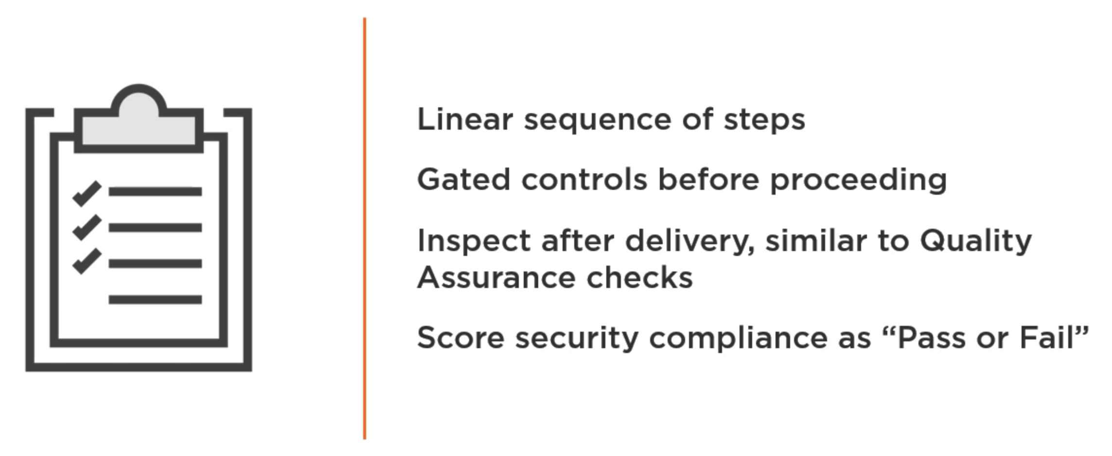
Traditional approach to Security Compliance

Slide 30
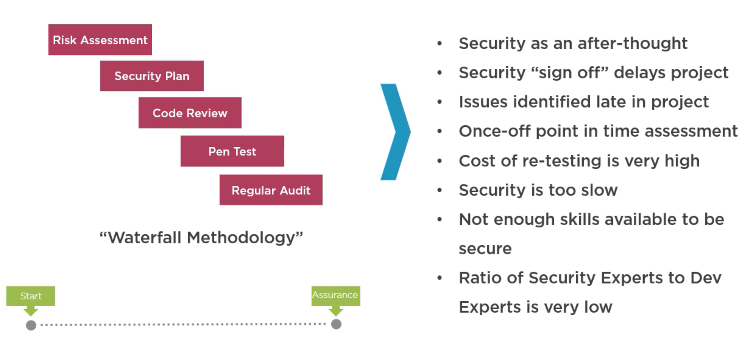
Information Security Friction

Slide 31
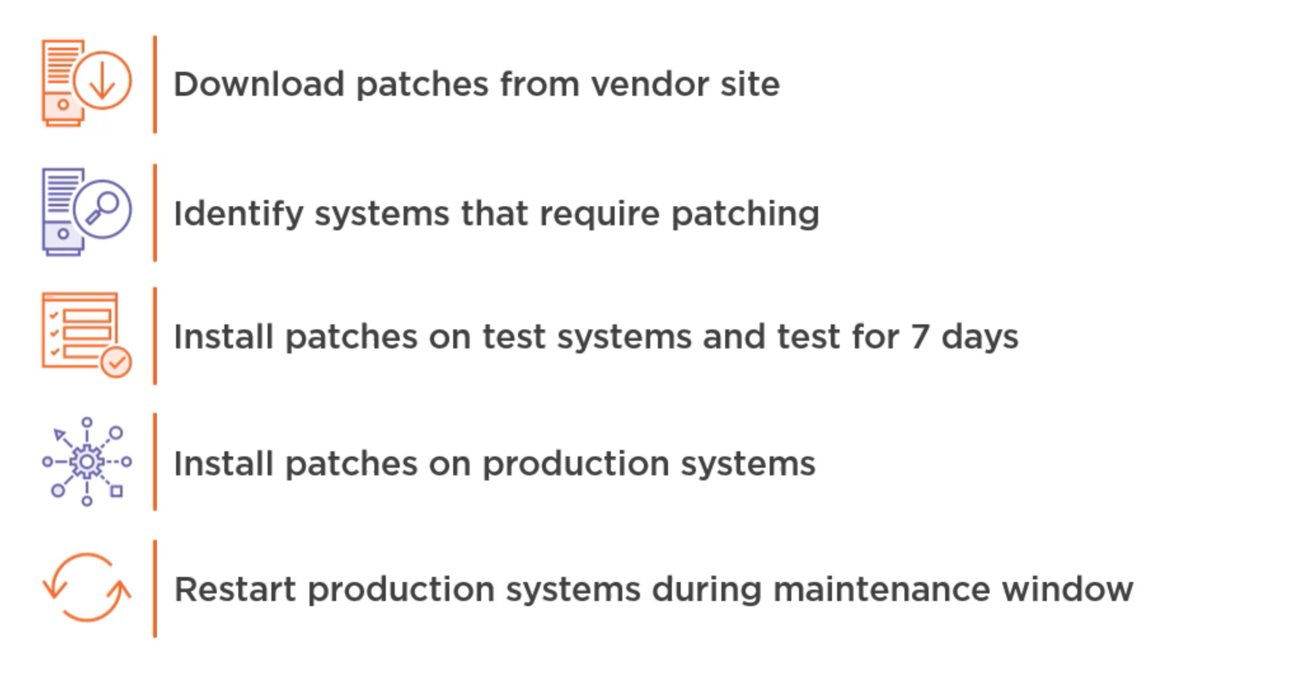
Traditional Approach

Slide 32
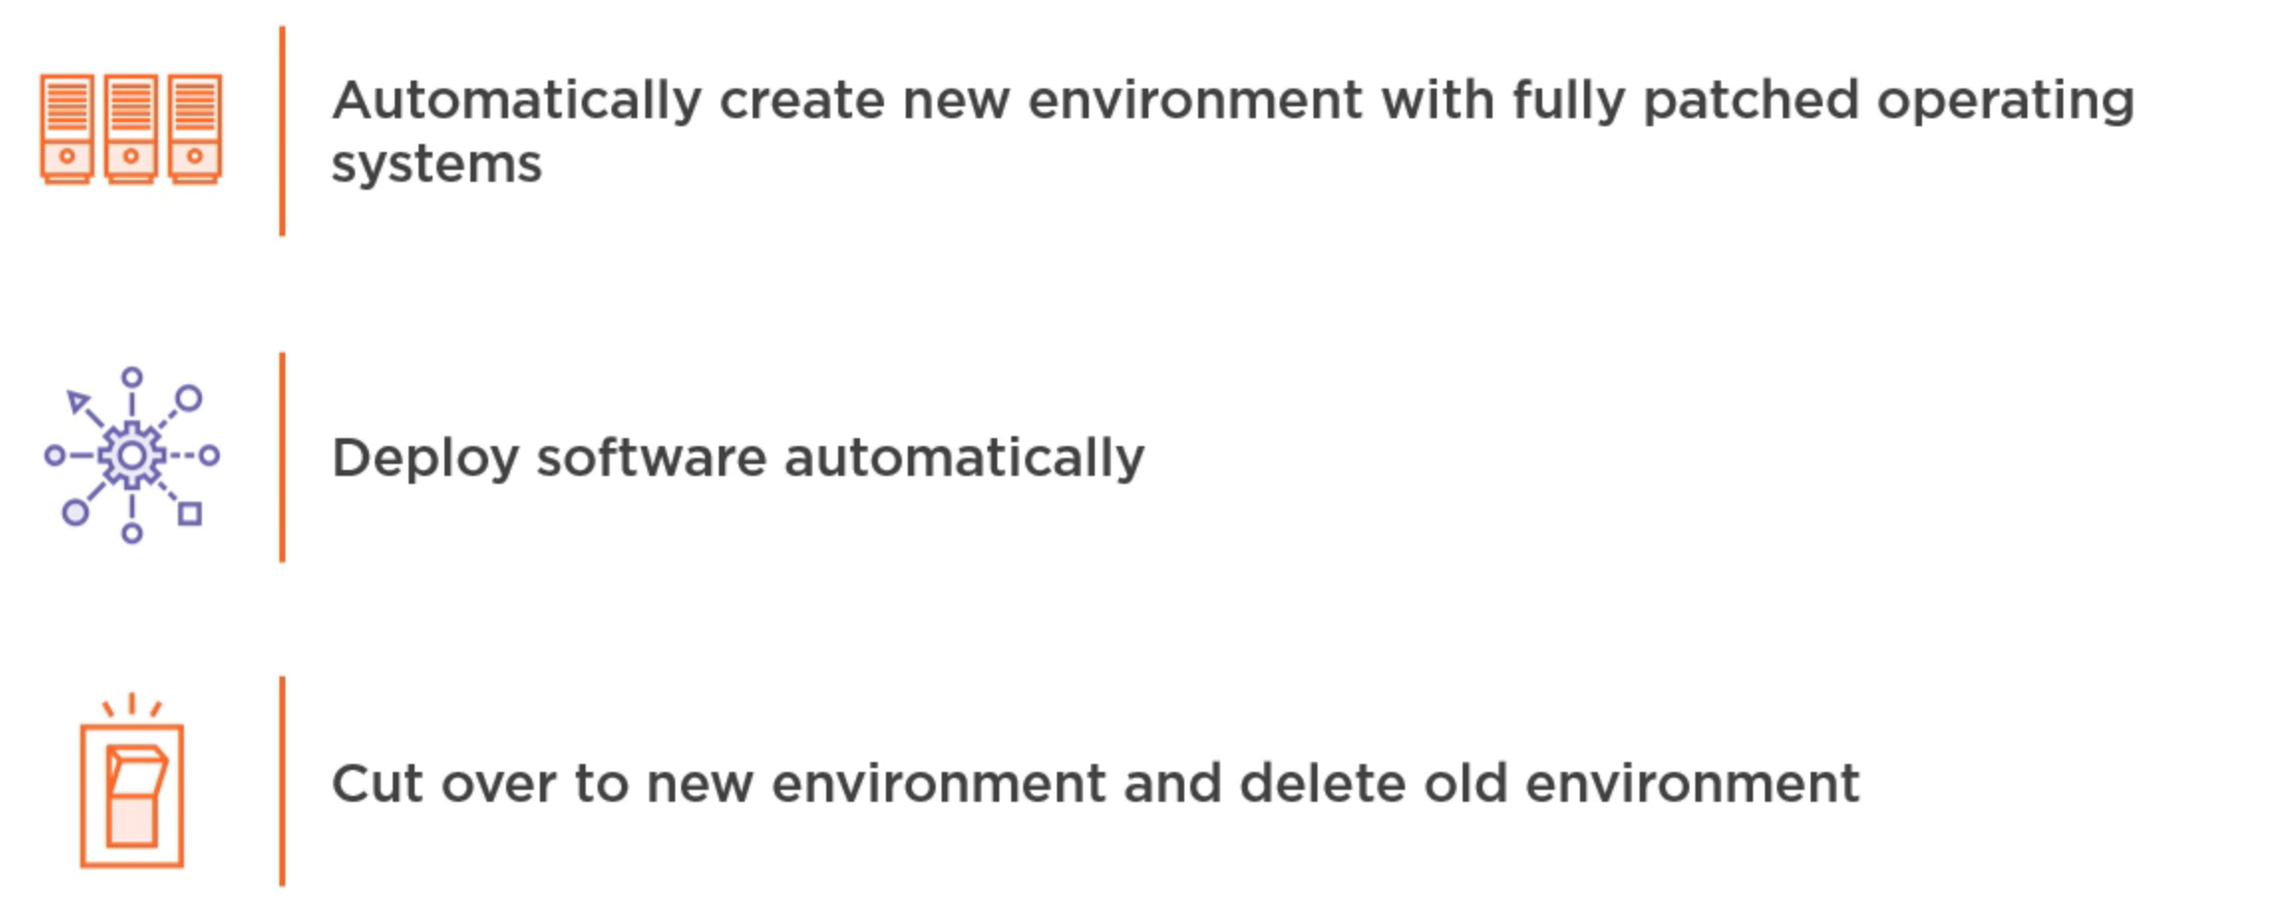
Automated Compliance Potential

Slide 33
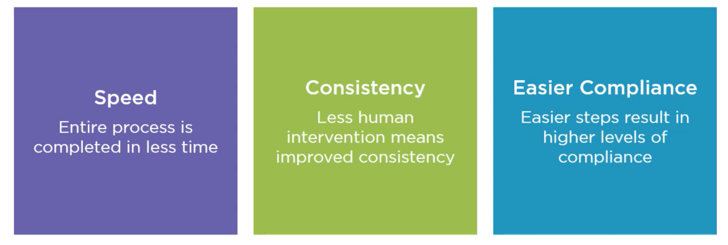
Compliance Benefits

Slide 34
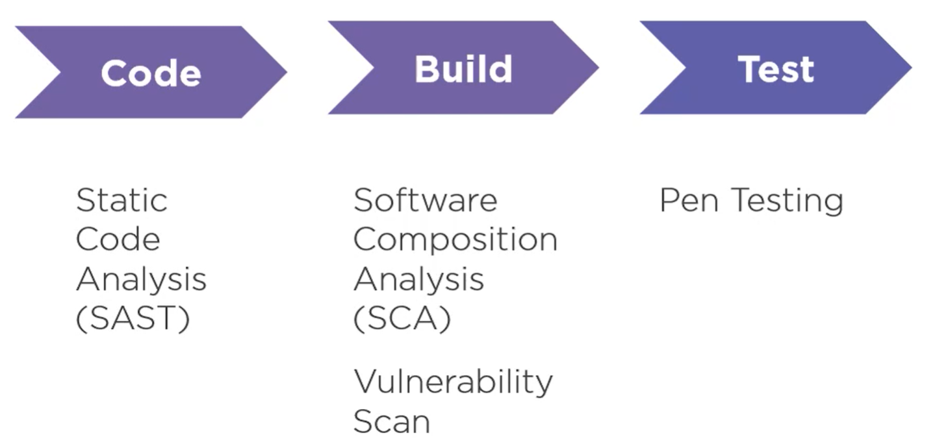
Breaking down the DevSecOps Pipeline

Slide 35
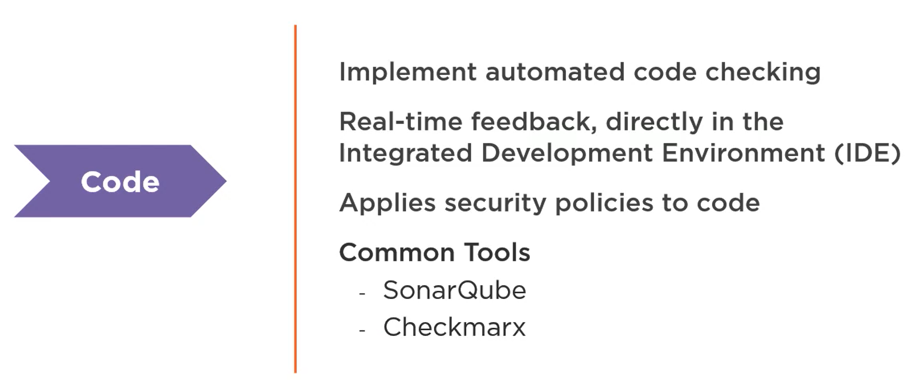
Code Stage

Slide 36
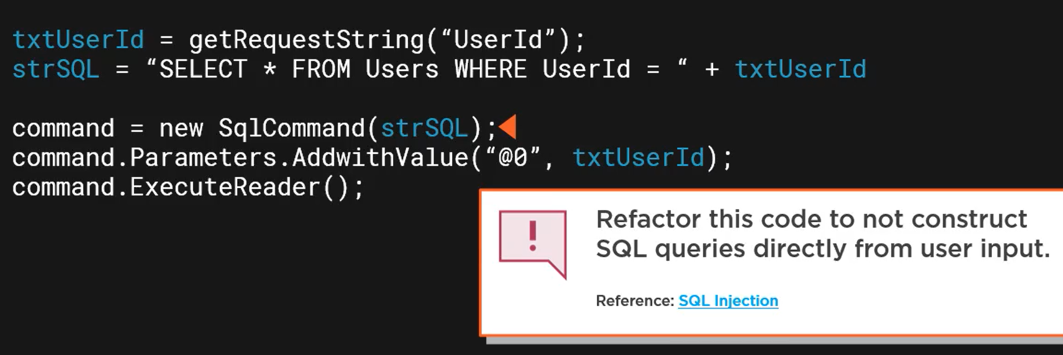
Static Application Security Testing

Slide 37
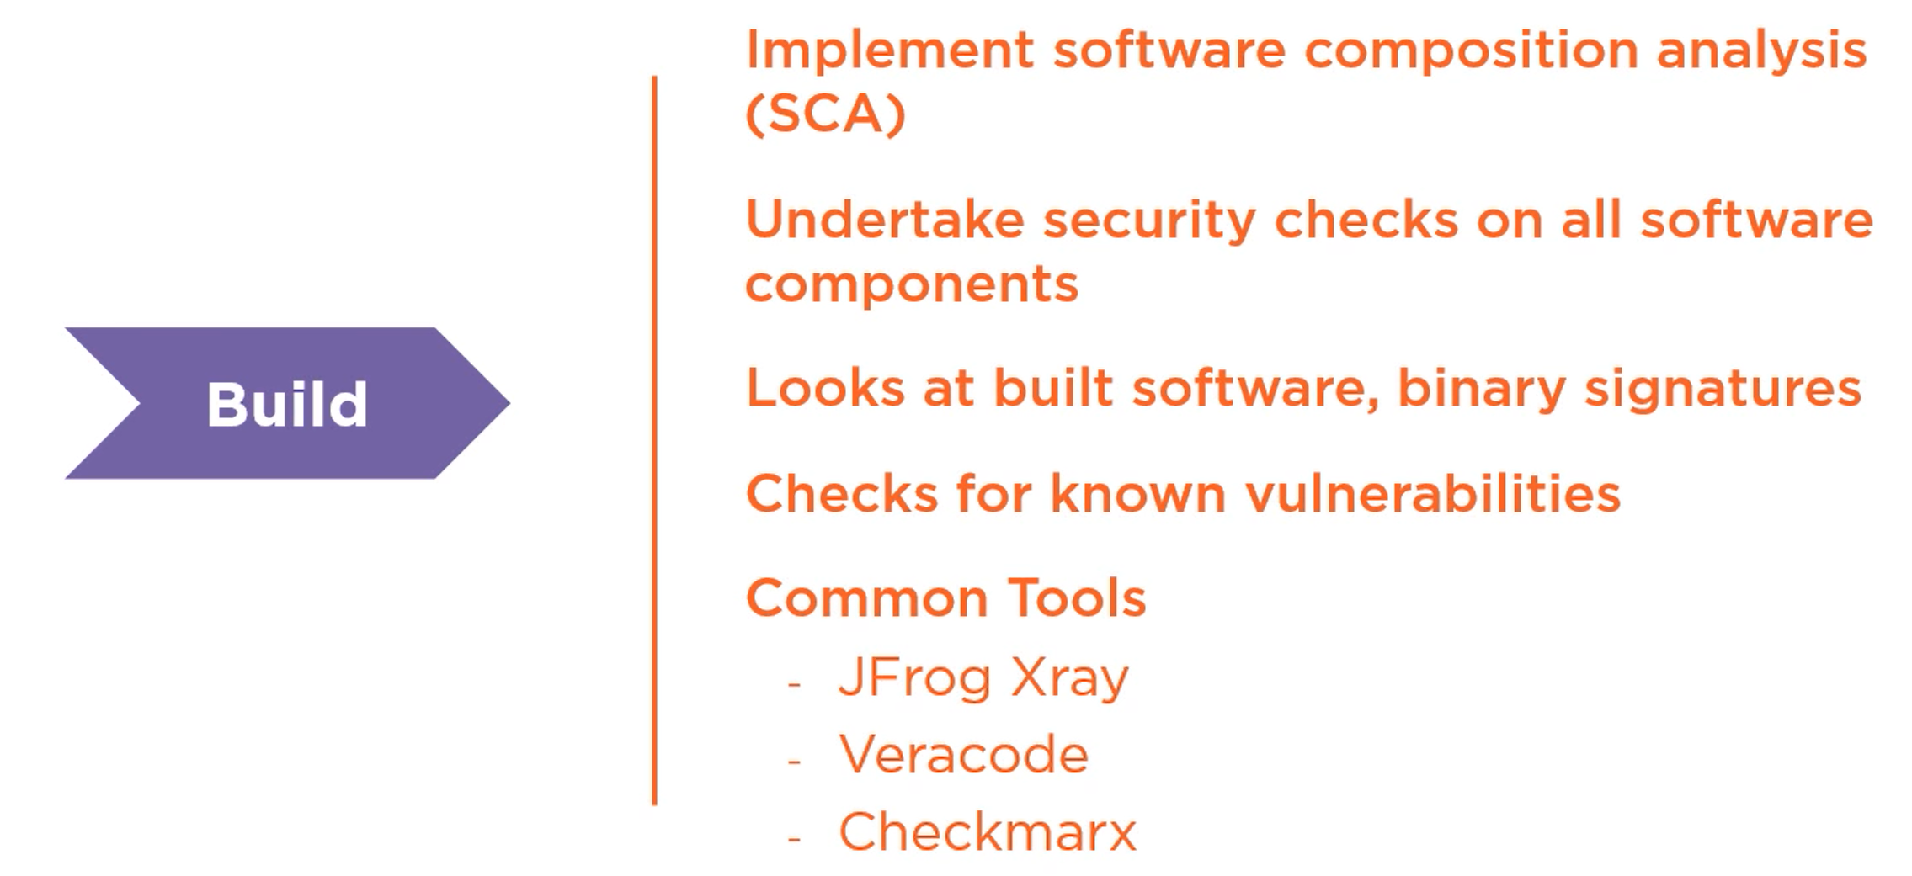
Build Stage

Slide 38
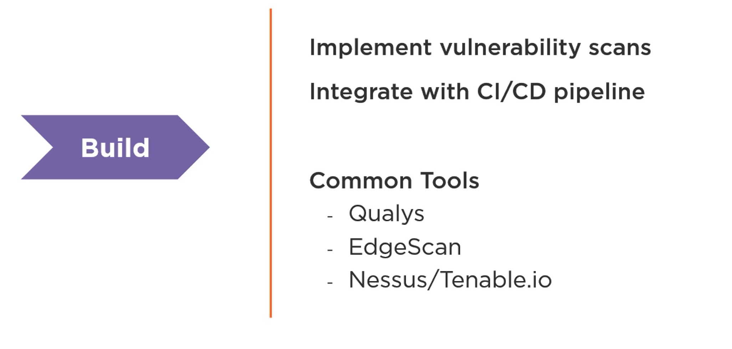
Build Stage

Slide 39
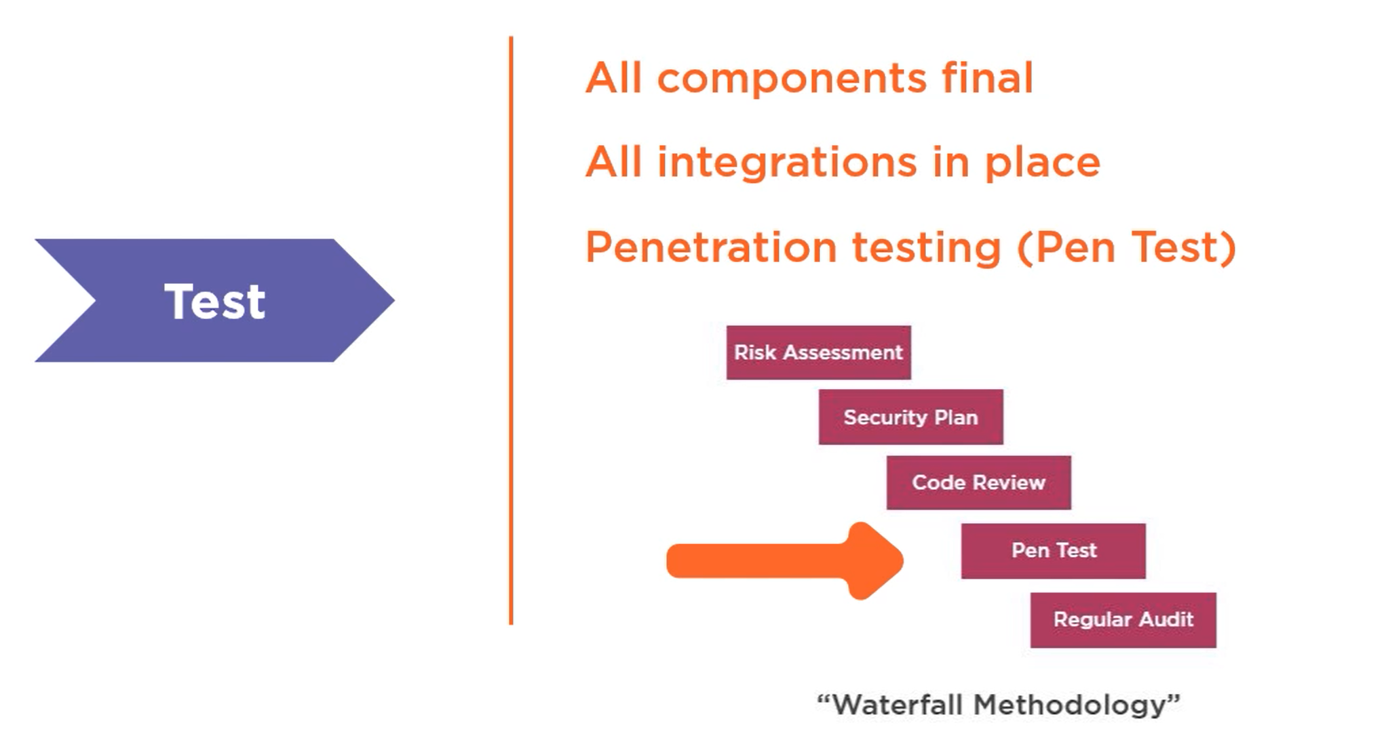
Test Stage

Slide 40
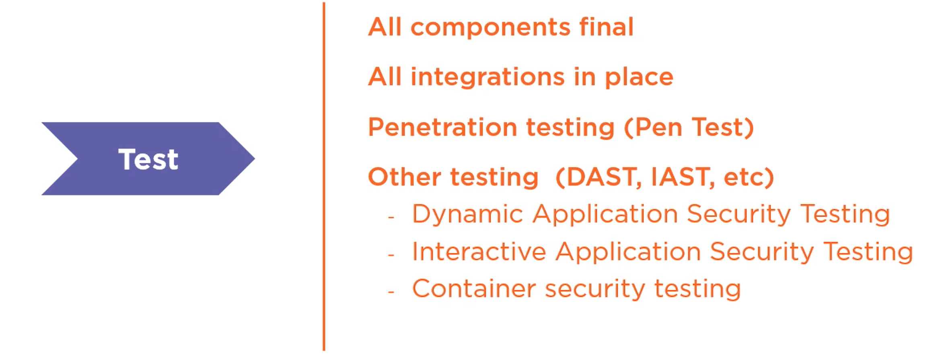
Test Stage

Slide 41
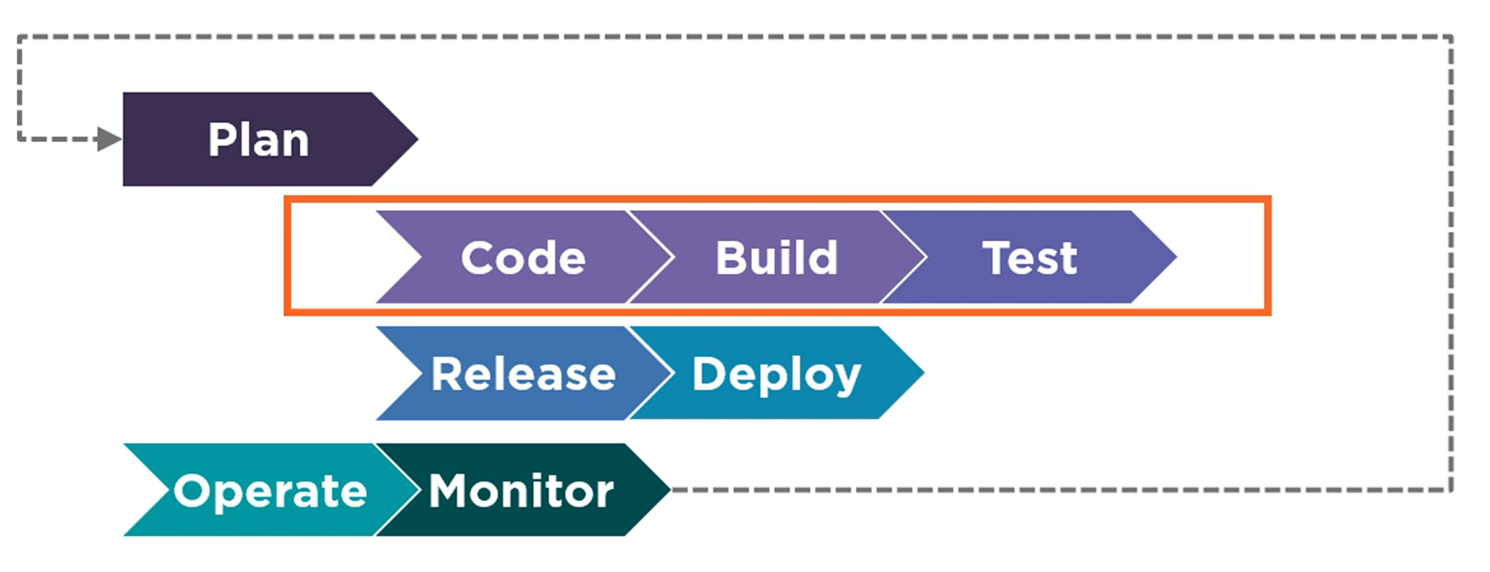
Breaking down the DevSecOps Pipeline

Slide 42
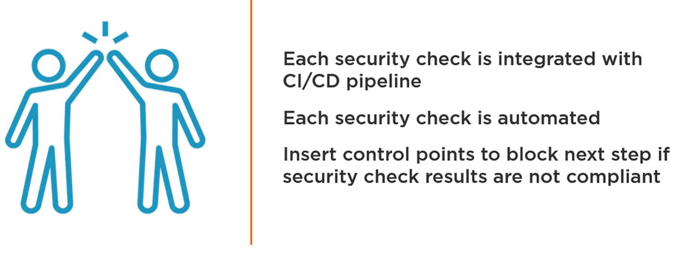
How to have good security Governance?

Slide 43
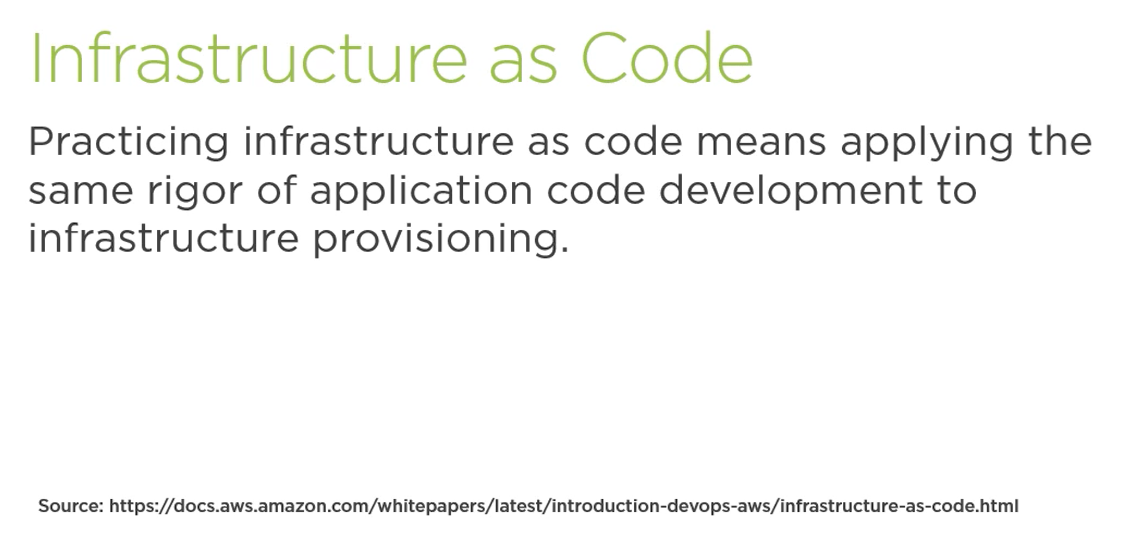

Slide 44
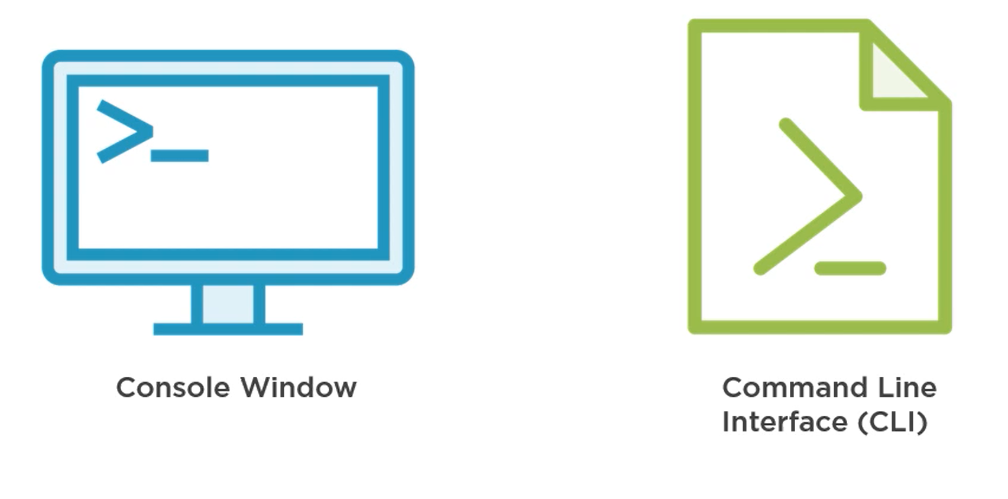
The Infrastructure as code interface

Slide 45
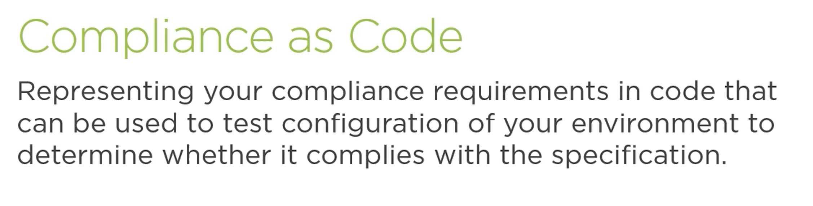

Slide 46
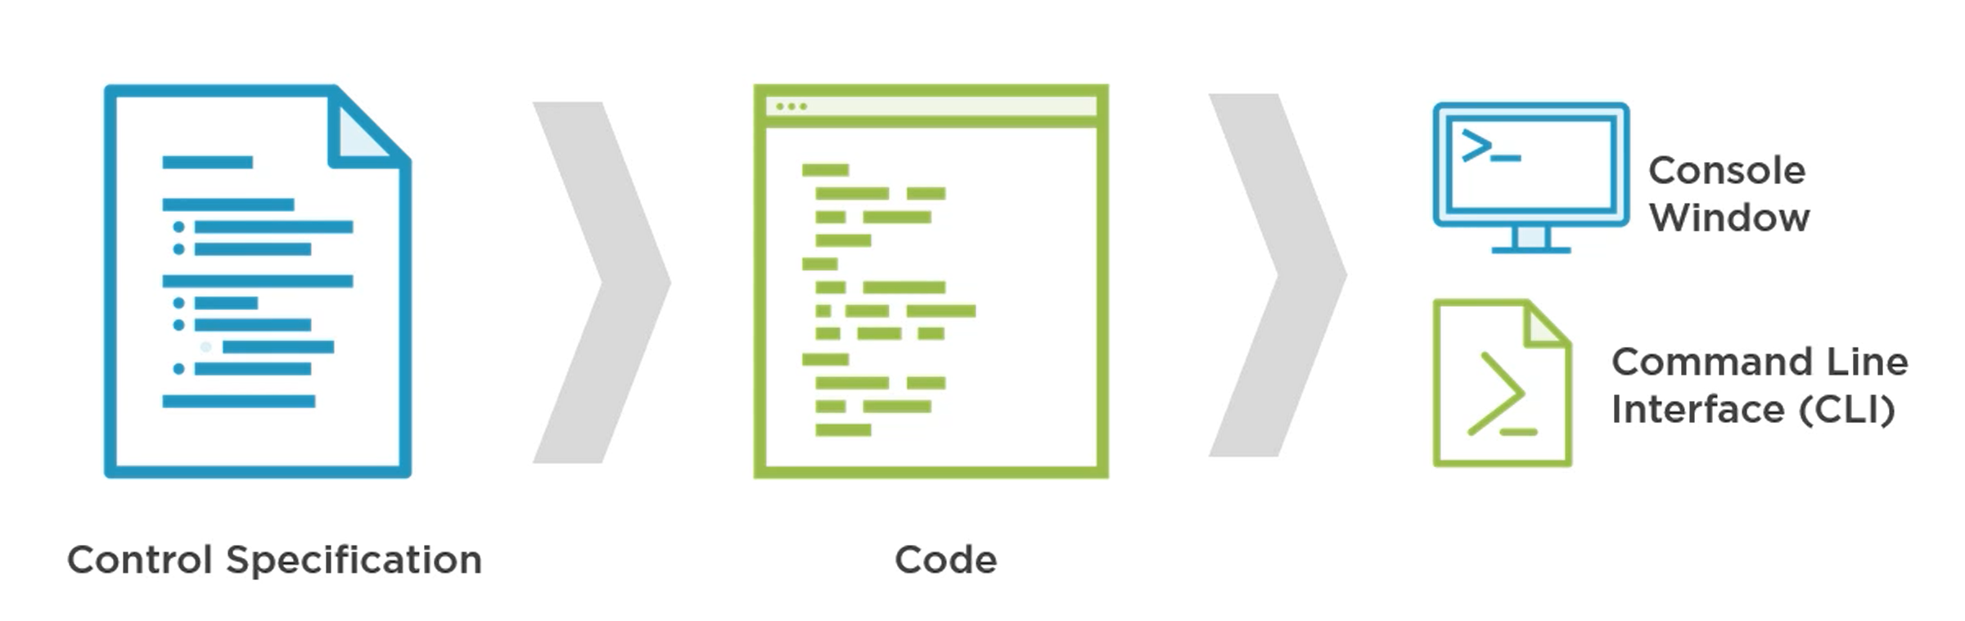
Map Controls to Code

Slide 47
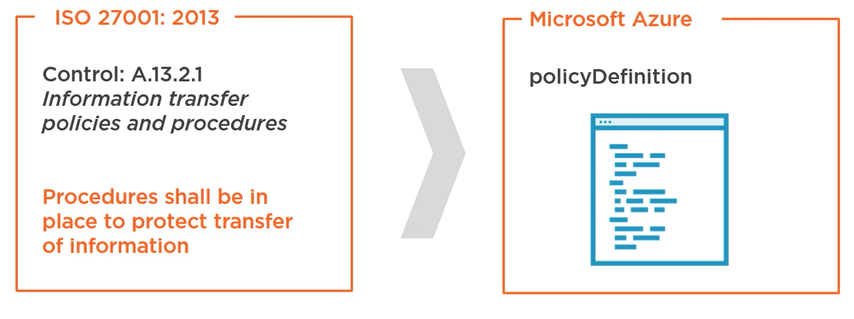
Compliance as code example

Slide 48
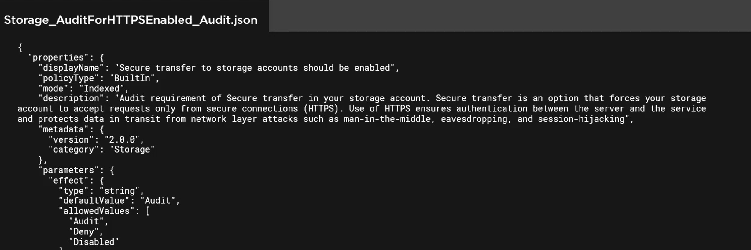
Ensure Information Transfer secure

Slide 49
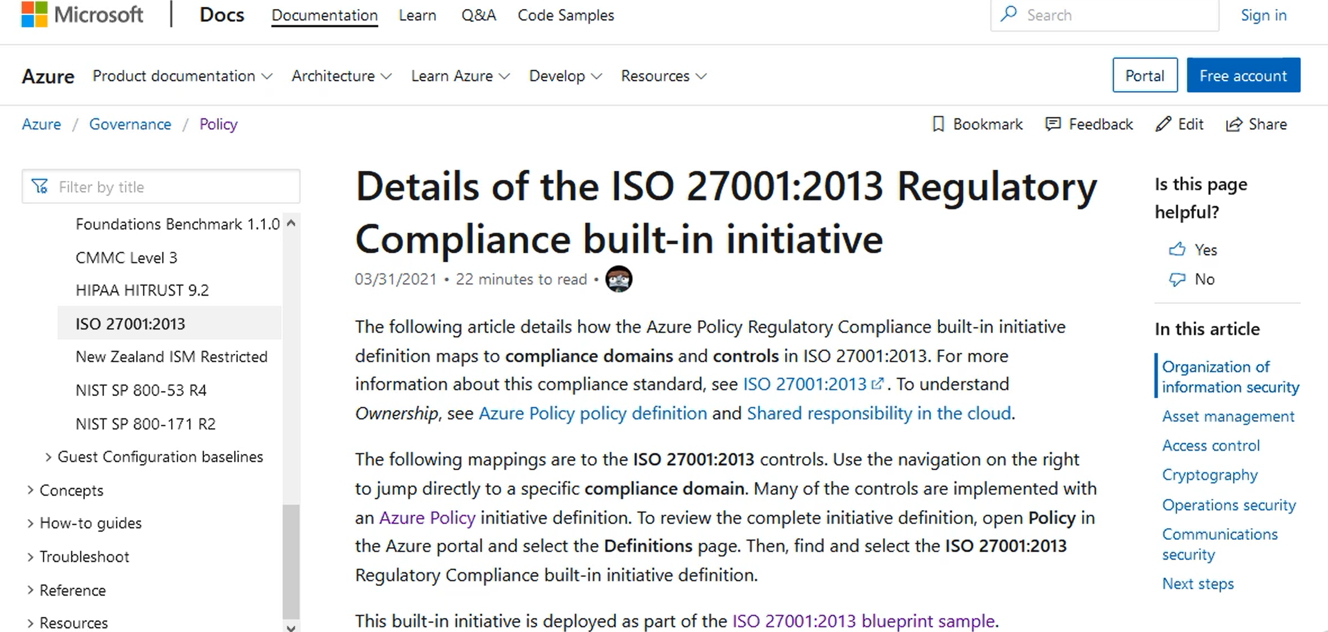

Slide 50
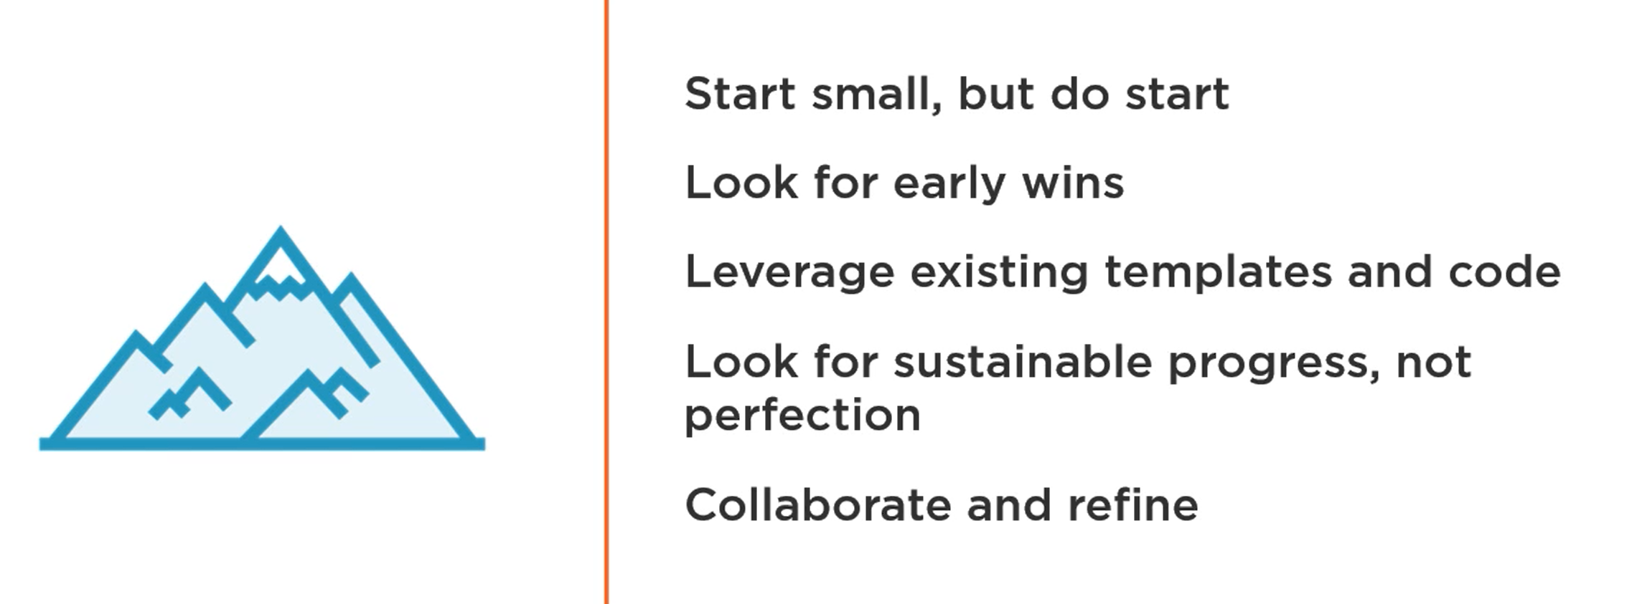

Slide 51
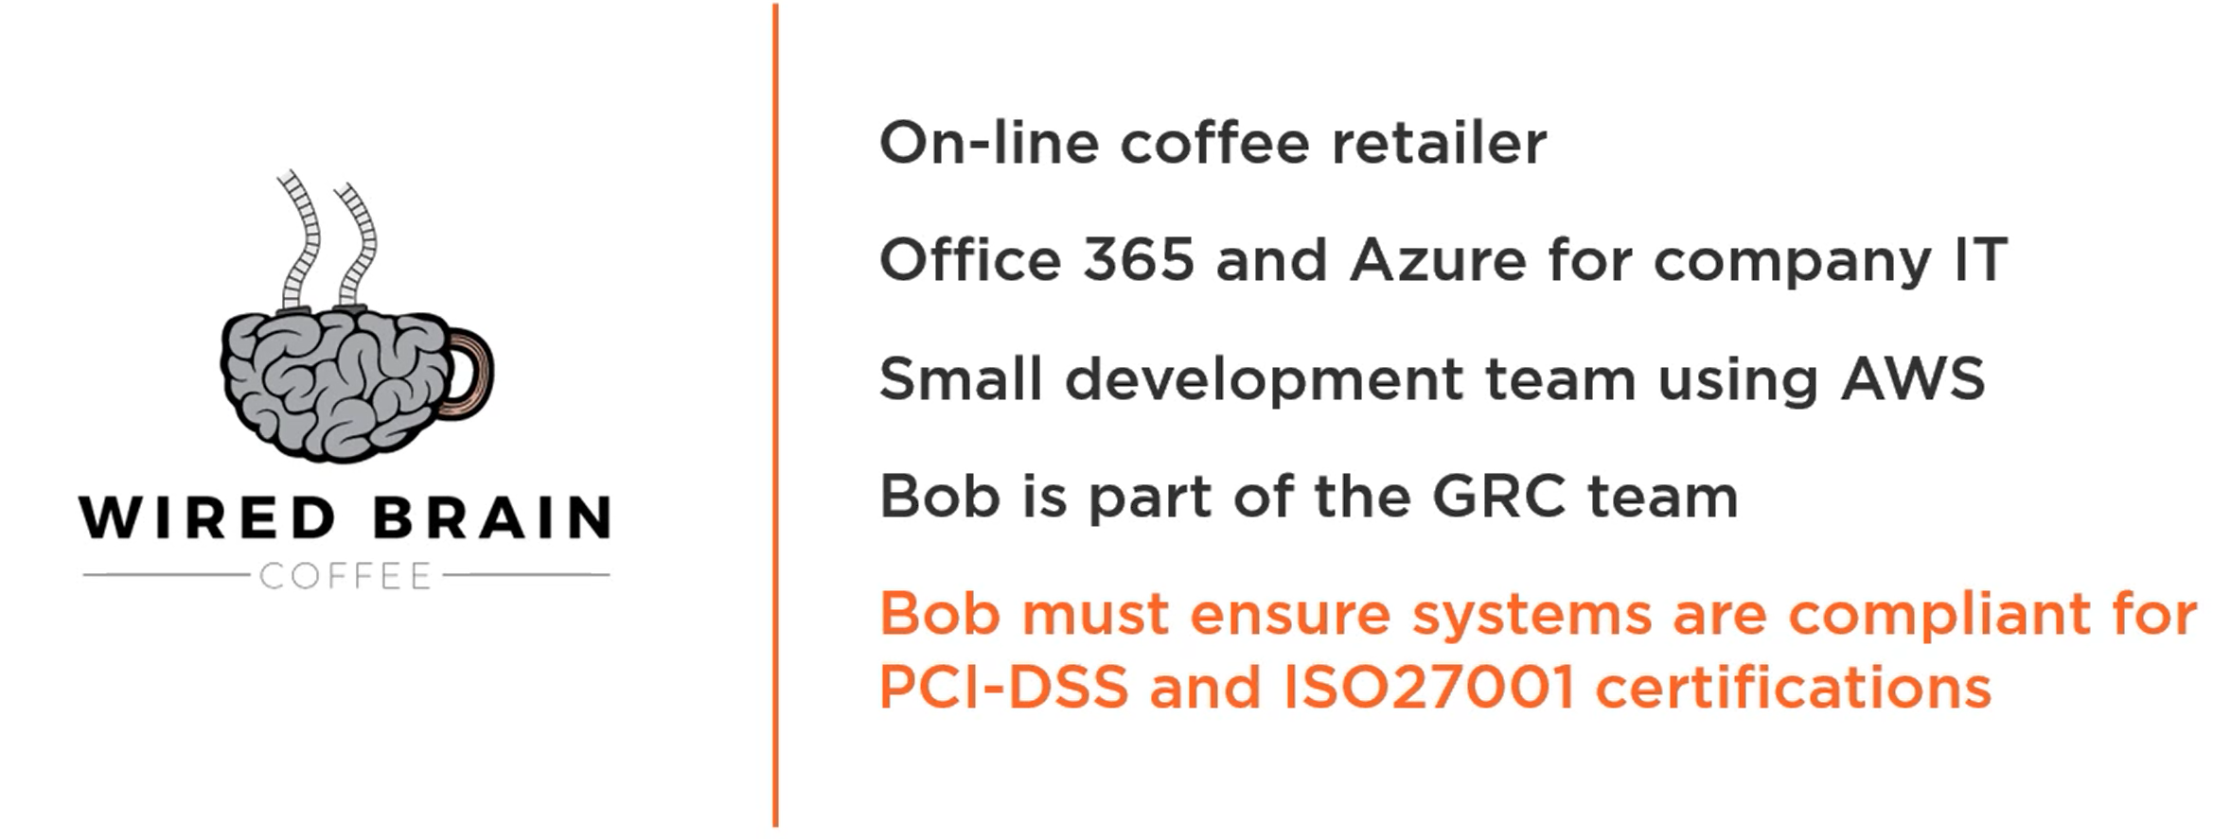
Scenario

Slide 52
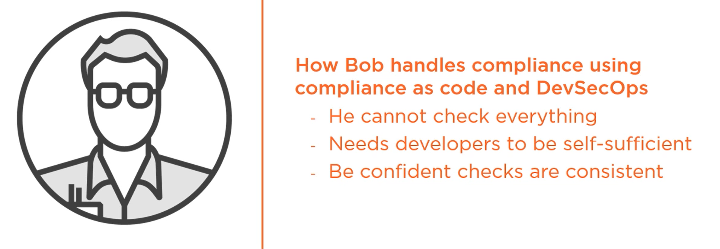
Bobs Challenge

Slide 53
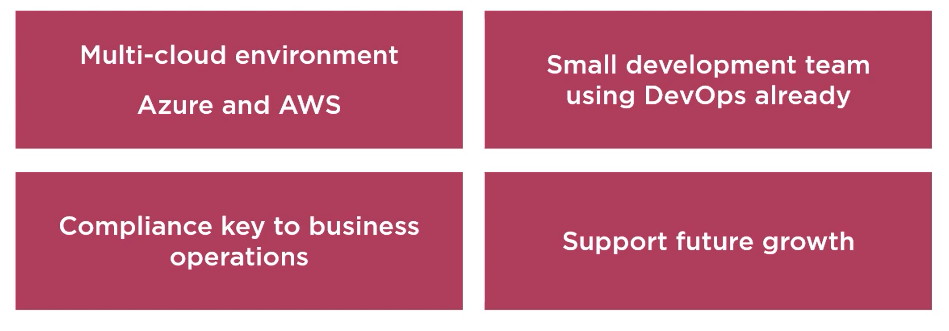
Key points of the scenario

Slide 54
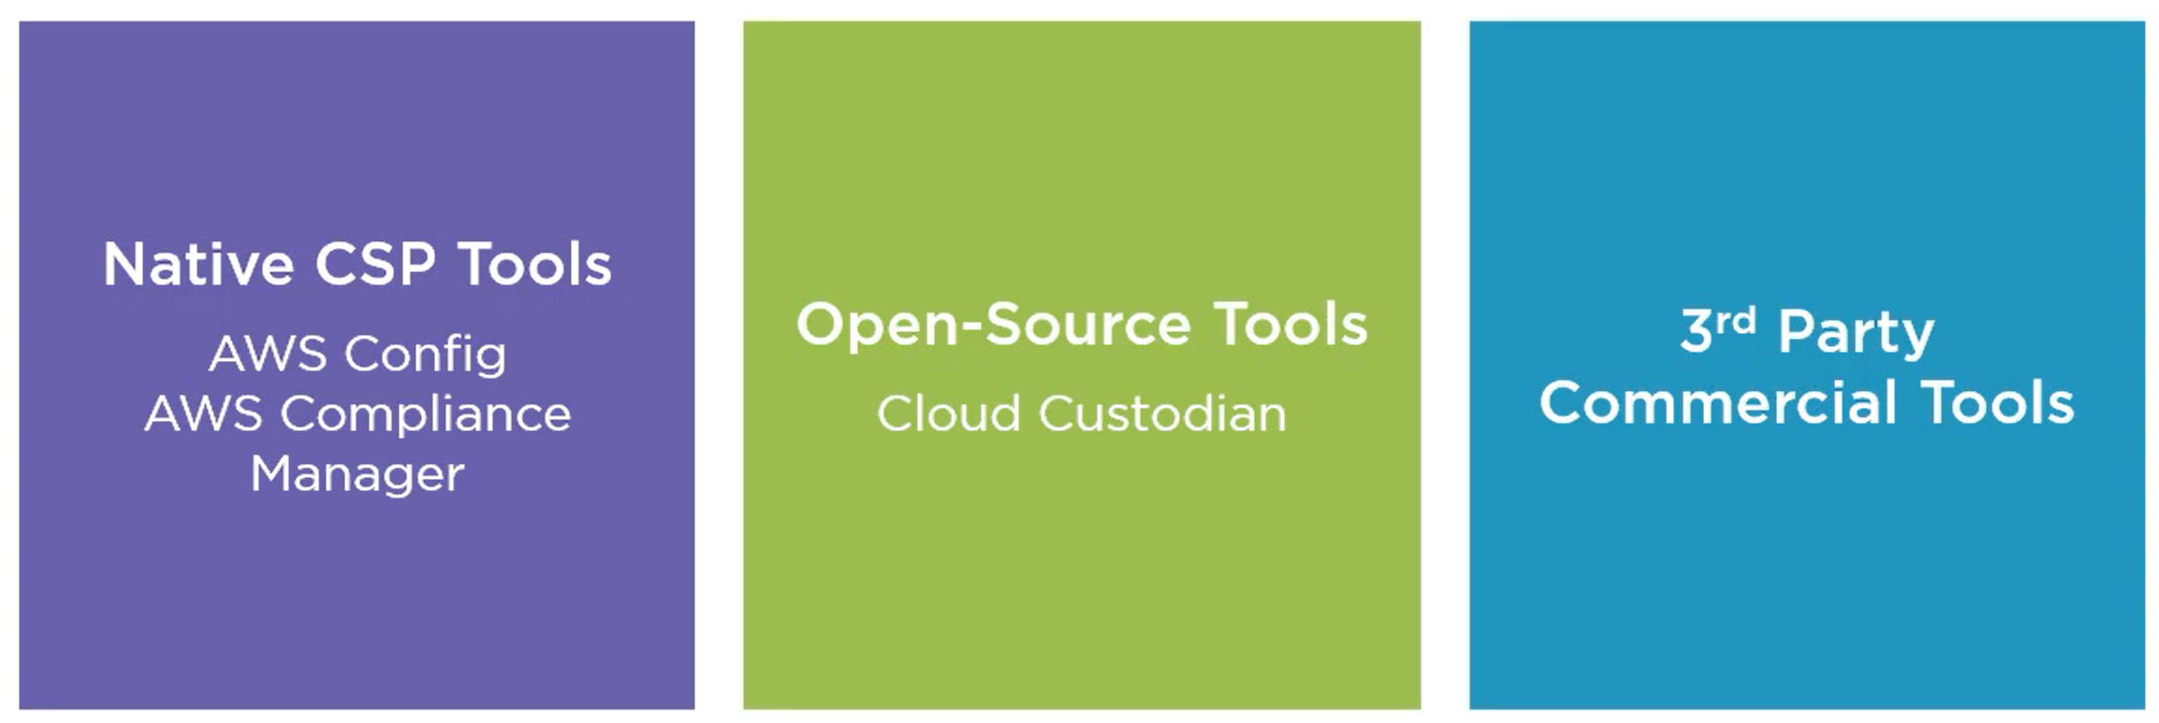
Compliance as tools

Slide 55


Slide 56
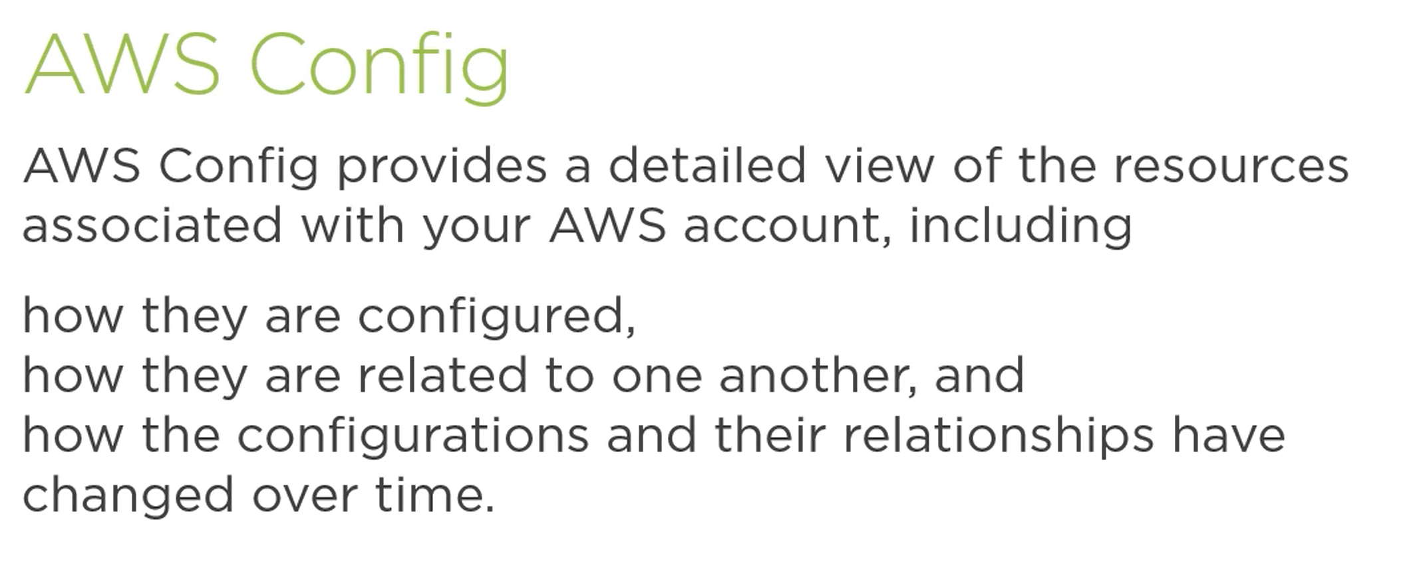

Slide 57
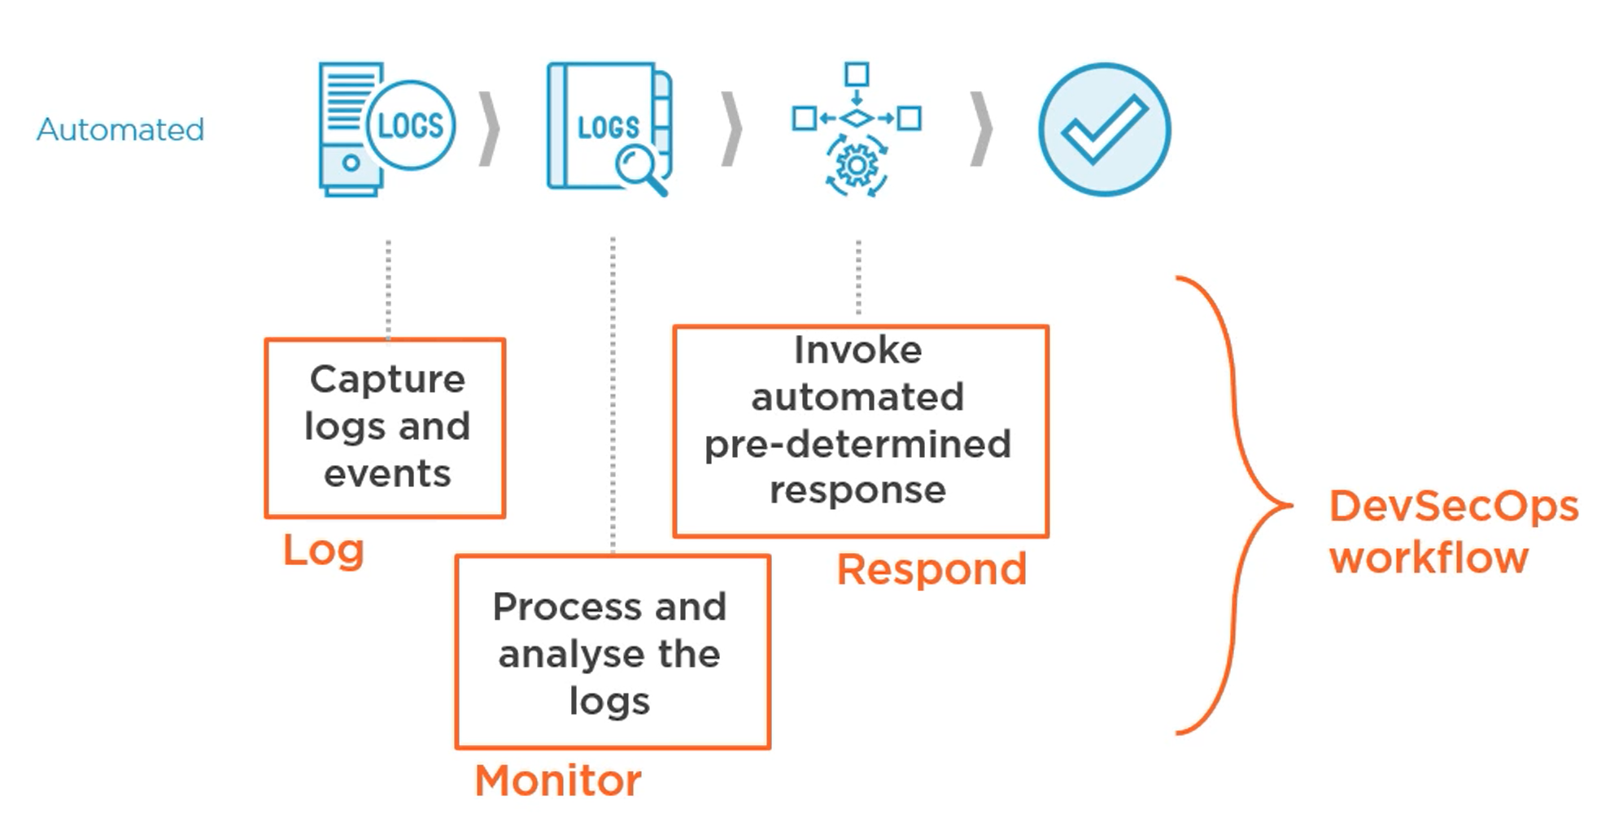
Incident Response workflow

Slide 58
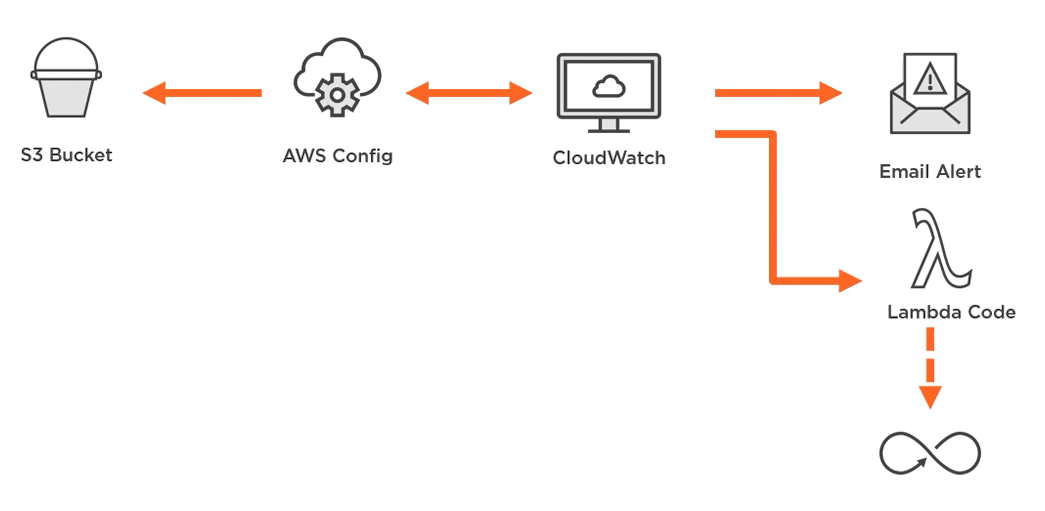
Wired Brain Coffee

Slide 59
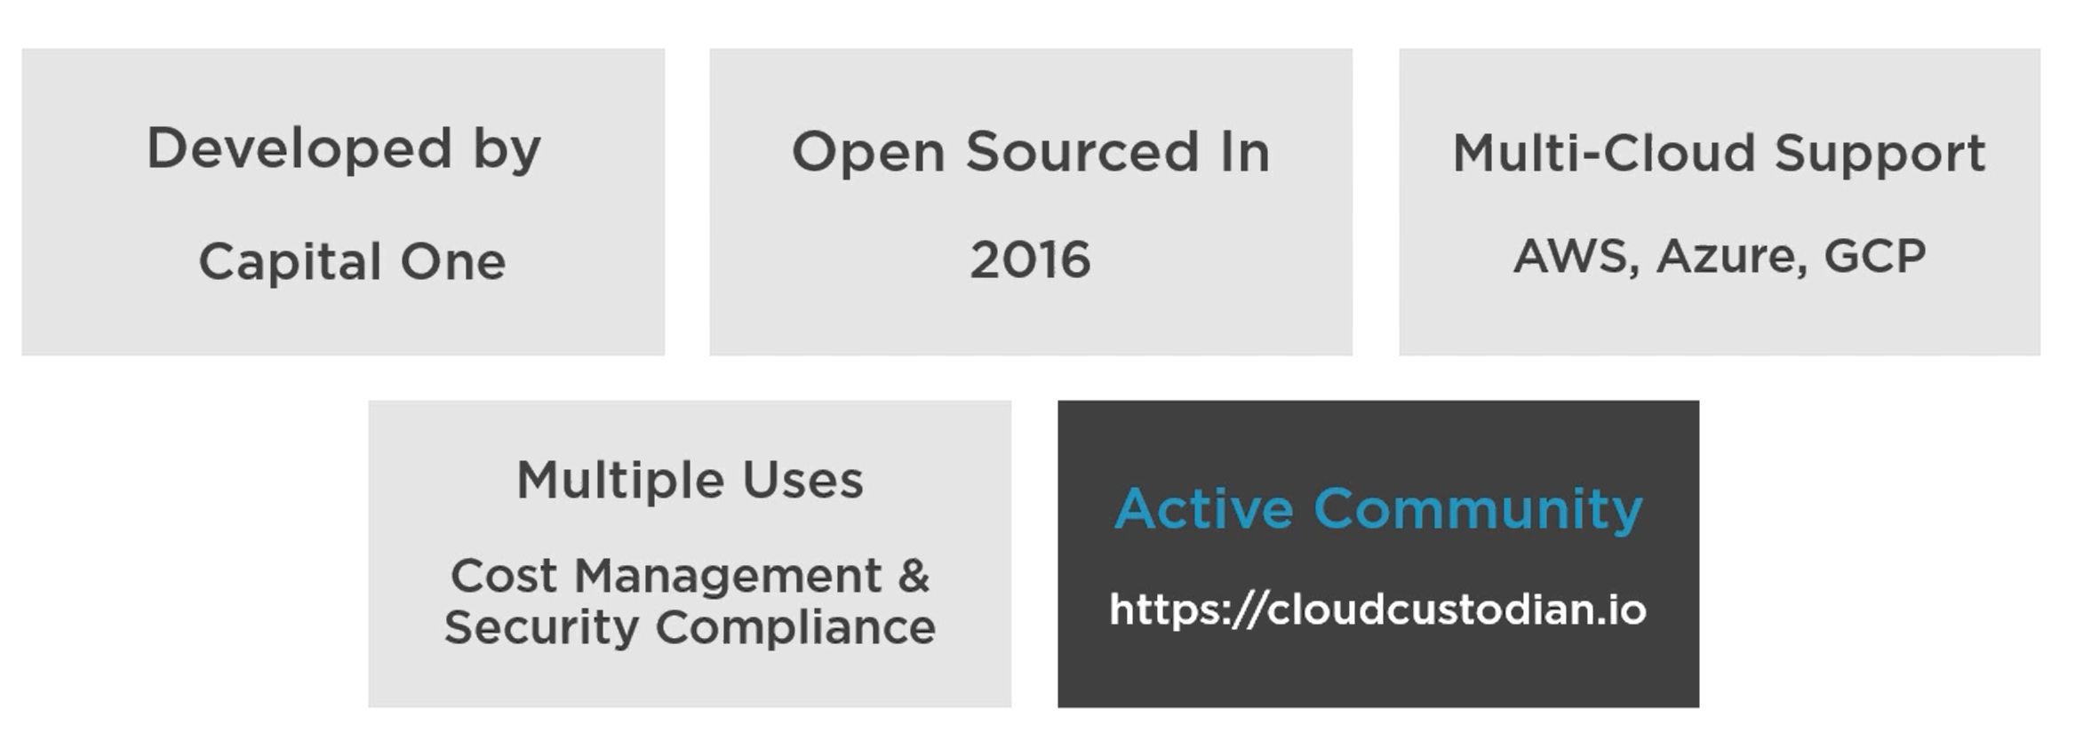
Open Source Cloud Custodian

Slide 60
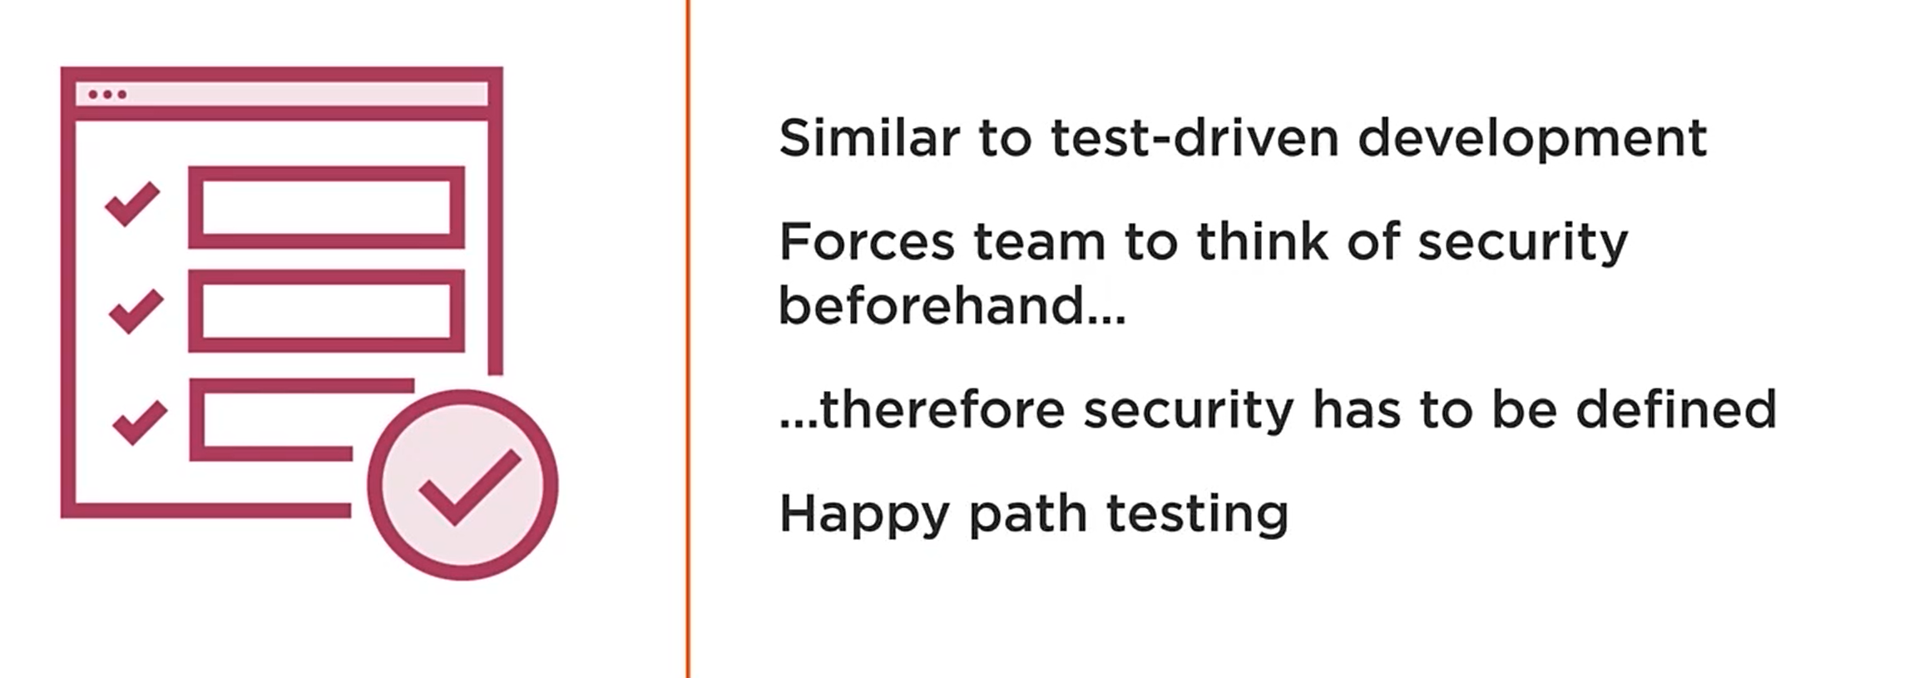
Test Driven Security

Slide 61
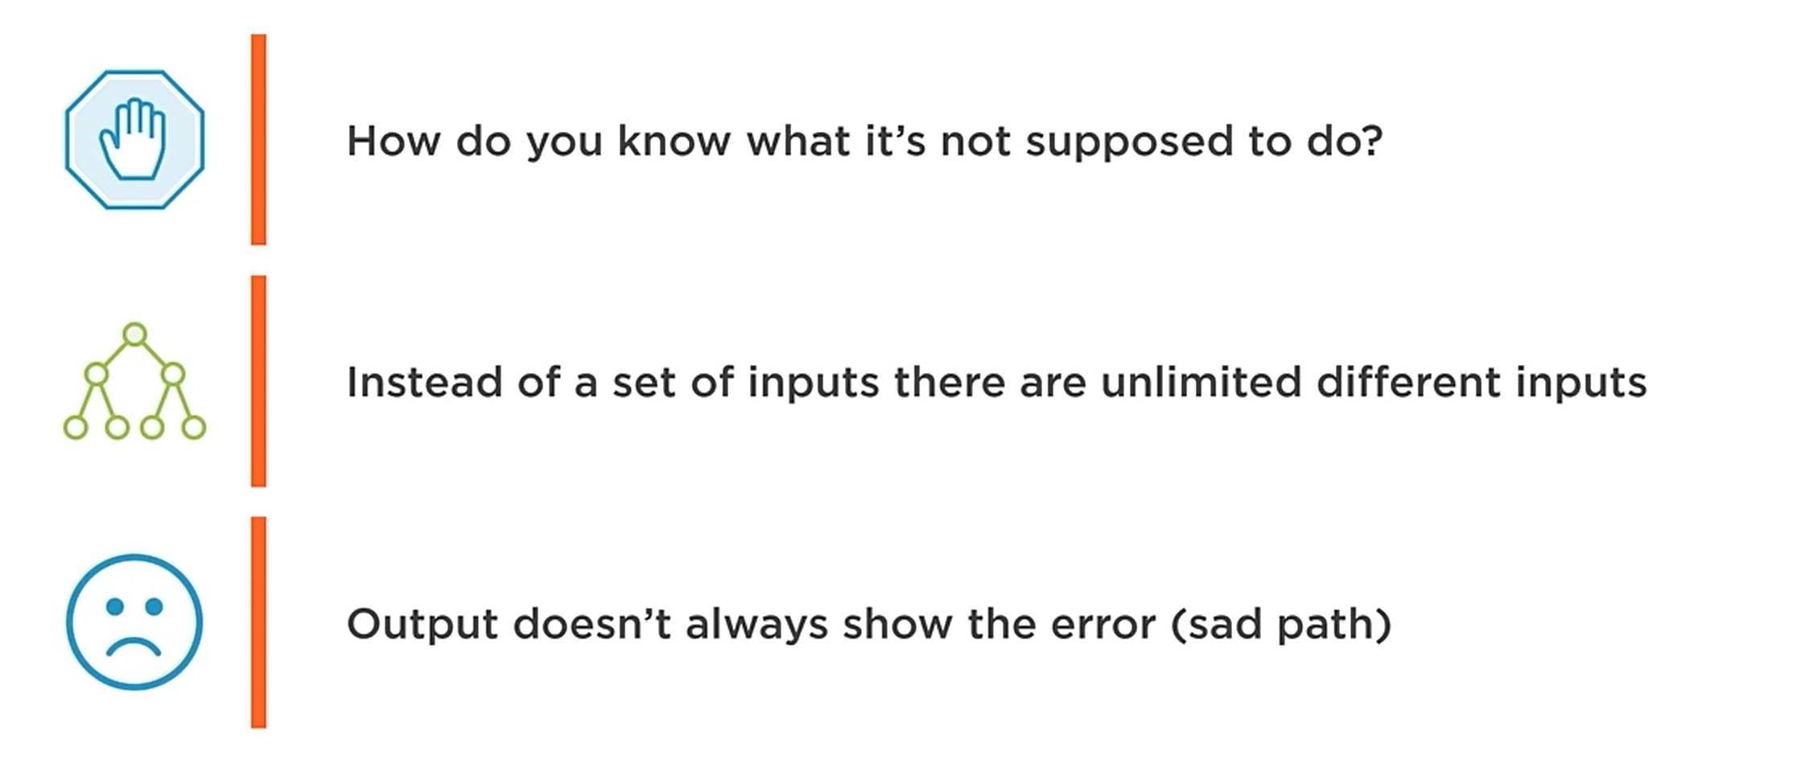
Negative Testing is Difficult

Slide 62
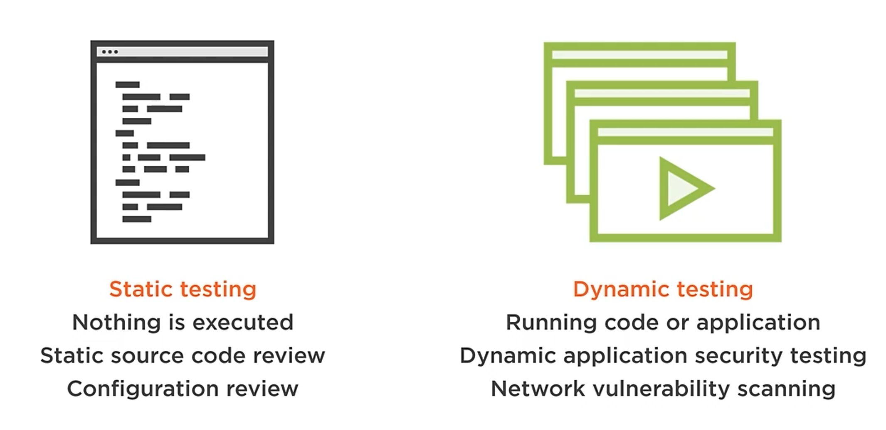
Two Methods of Testing

Slide 63

Types of security Testing

Slide 64

SAST

Slide 65

Dynamic Application Security Testing

Slide 66

Automated Vulnerability Scanner

Slide 67

Automated Vulnerability Scanner

Slide 68

Automated Security Testing

Slide 69

Manual vs Automated

Slide 70


Slide 71
Debunking DevSecOps Myths
Special Teams
Delays to deployments
Buying DevSecOps

Slide 72

We can’t Introduce DevSecOps Because…

Slide 73

We can’t Introduce DevSecOps Because…

Slide 74

We can’t Introduce DevSecOps Because…

Slide 75

We can’t Introduce DevSecOps Because…

Slide 76

We can’t Introduce DevSecOps Because…

Slide 77
Questions ???

